Slide 1
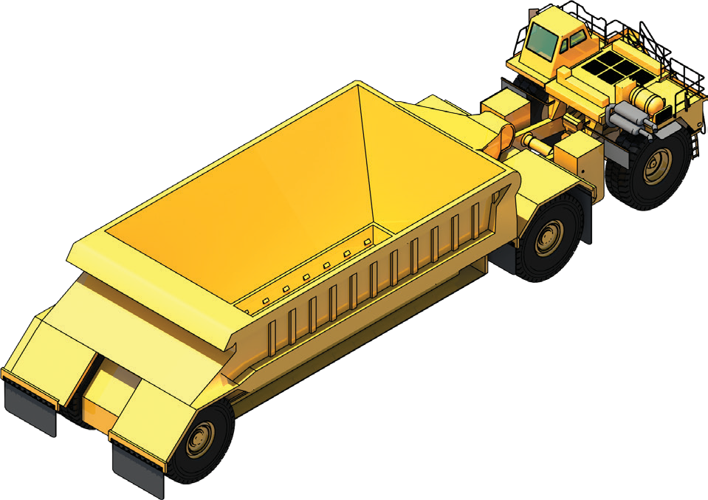
LEARNER GUIDE
Belly Dump
Truck
Training support material for:
RIIMPO336E
Conduct belly dump truck operations
Produced by:

Slide 2
Introduction to Belly Dump Trucks

Slide 3
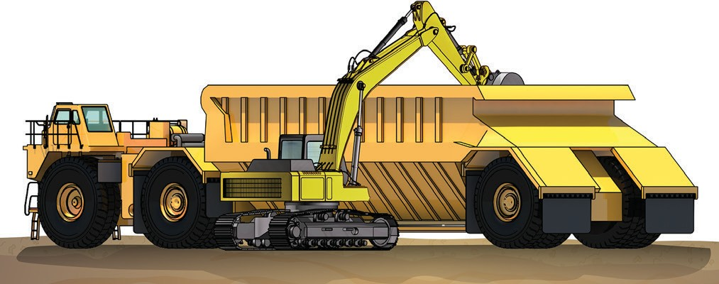
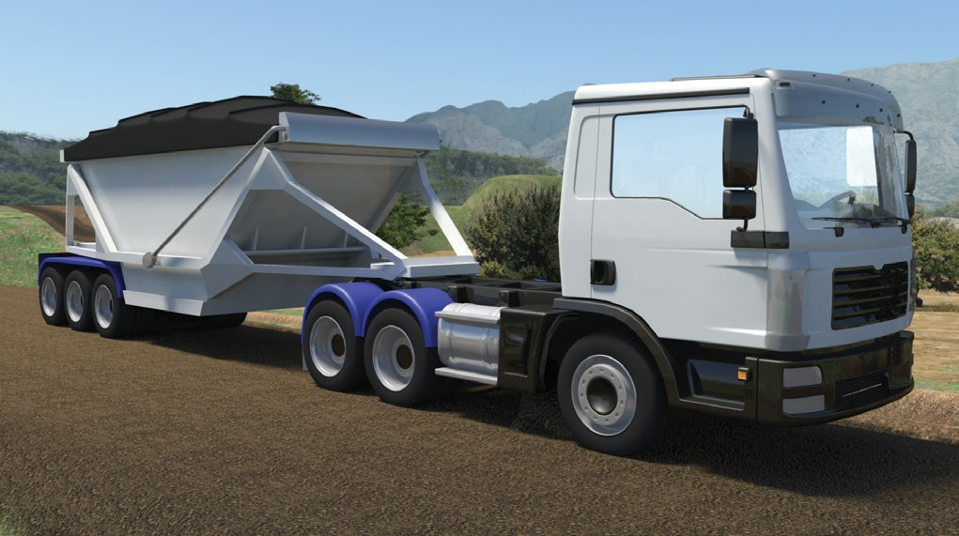
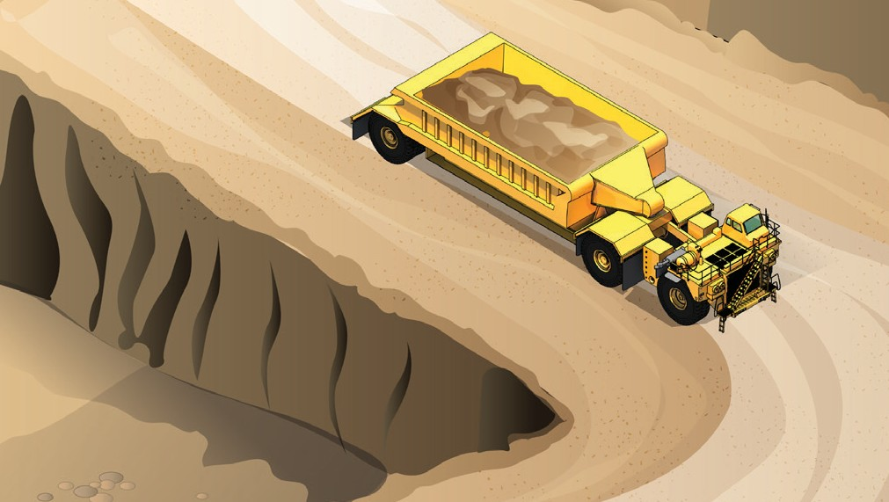
Introduction to belly dump trucks
PC 2.3 INTRODUCTION TO BELLY DUMP TRUCKS
This guide covers belly dump trucks. A belly dump truck is a machine used to carry materials from one place to another. You can load a belly dump truck with a number of machines including excavators and loaders.
The belly dump trucks covered in this guide are on-highway and off-highway trucks, such as diesel-mechanical and diesel electric drive. On-highway types are a prime mover and trailer. Belly dump trucks are usually articulated.
On-highway
Off-highway
A belly dump truck discharges it's load through the bottom of the body. Dumping is controlled by a set of doors referred to as clam shells or hatches.

Slide 4
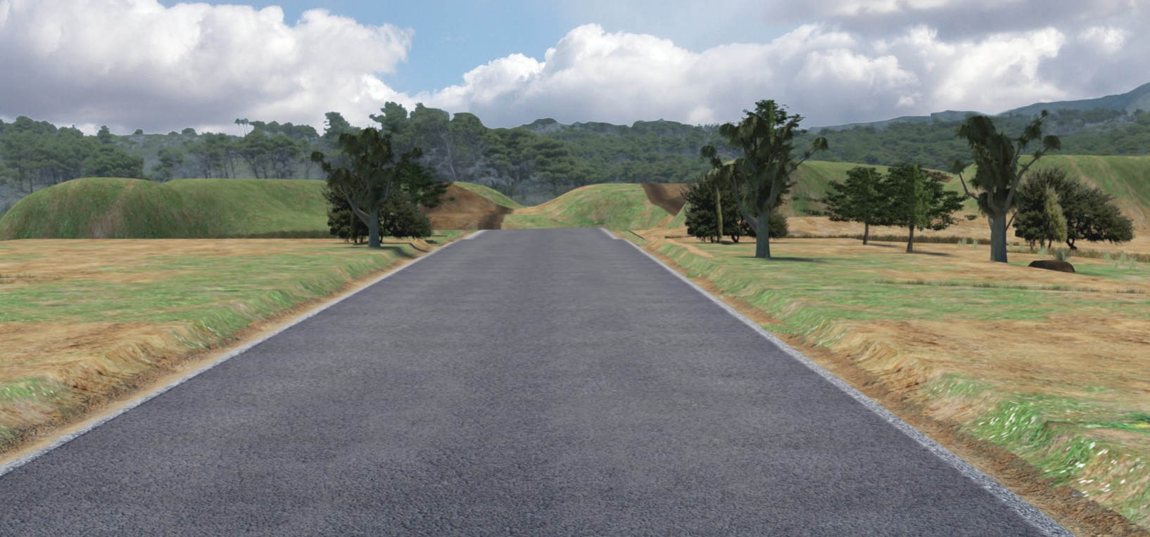
The basics of road construction

Slide 5
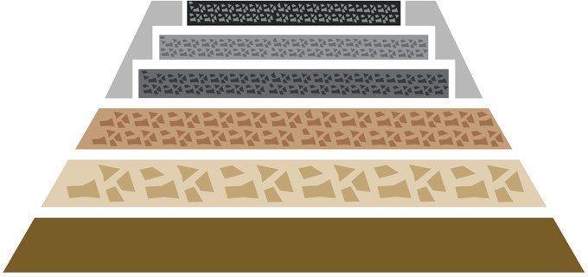
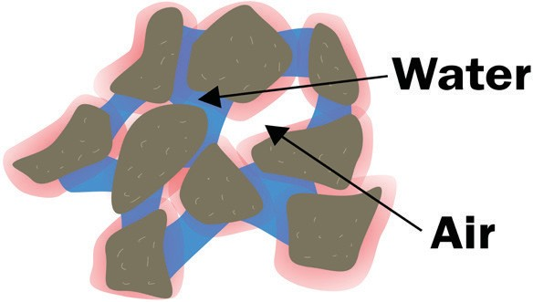
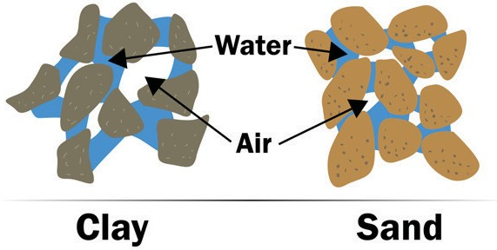
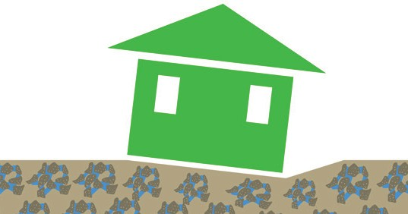
THE BASICS OF ROAD CONSTRUCTION
Principles of soil technology for civil works
One of the most important jobs you will do, as a machine operator, is to help lay foundations. Foundations are the base for roads, railway lines, swimming pools and buildings. If you do not have a solid foundation, you cannot build something solid on top of it. | In civil construction, moisture content means how much water is in a soil, rock, aggregate or road base. Moisture is very important in earthmoving. Moisture affects the weight of soils. It makes soils swell, and it also affects the handling properties of the soil. Handling properties means how easy or hard it is to work with that soil.
All soils usually contain moisture. How much moisture the soil has depends on many things. The weather, drainage, and the soil’s ability to hold water all affect the moisture in a soil. Retention properties mean how much water a soil can hold. Different soils can hold different amounts of water. Sometimes you can treat a soil to change its moisture content. To do this you mix a chemical with the soil. | Different types of soils can cause problems with foundations. Wet, boggy soil can cause foundations to sink. That is why it is important to make sure water can run or drain from the site. It is also important that the foundation is built up to the right level. You can sometimes treat wet boggy soil with lime. Lime helps dry out the soil, and helps it ‘clump’ together.

Slide 6
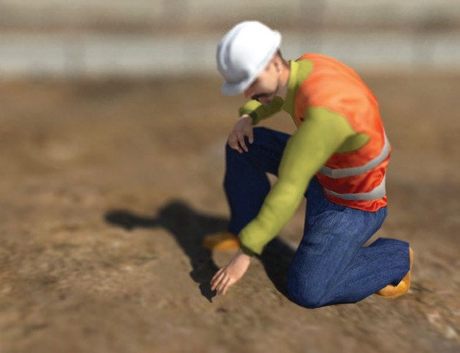
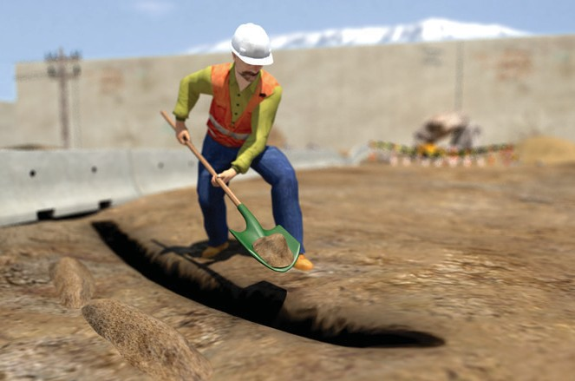
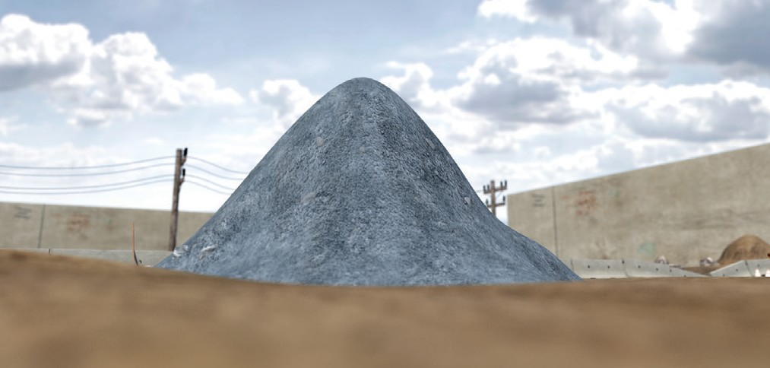
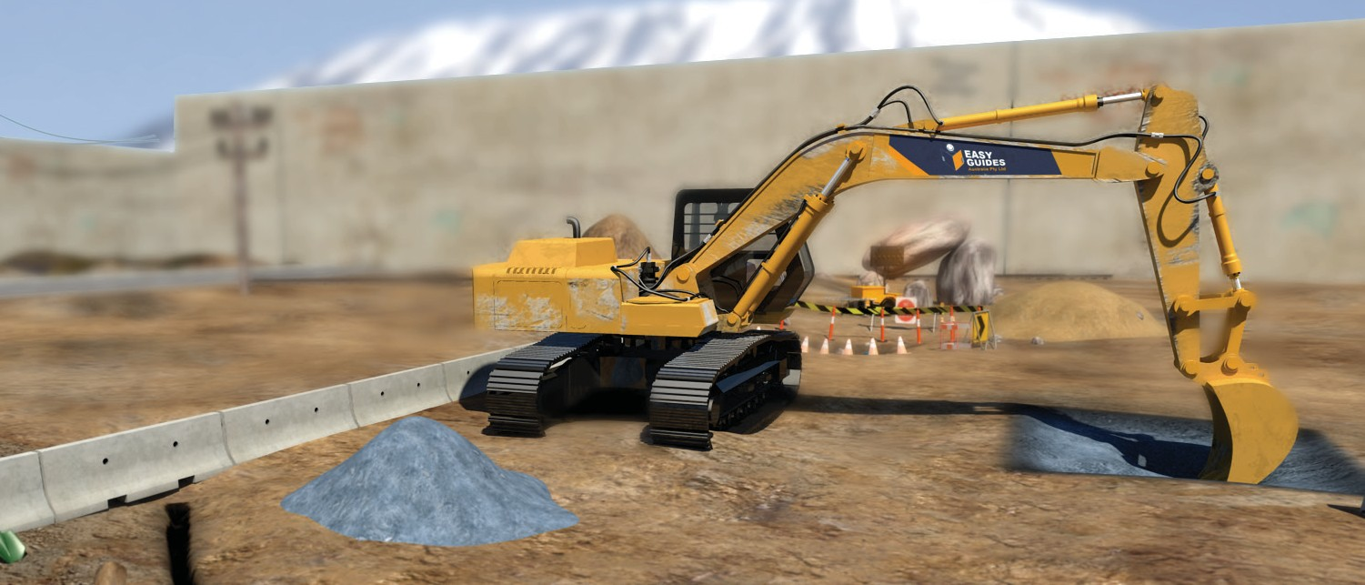
Operating techniques
THE BASICS OF ROAD CONSTRUCTION
Building a stockpile
A stockpile is a pile of material (soil, sand, rock, etc) that you use for earthmoving work. You must choose a good location for your stockpile. If you choose the wrong location, your stockpile could get washed away or become dirty (mixed with other materials).
If you can, choose an area of well drained, firm level ground. | You should set up drainage so that rainwater does not cause the stockpile to wash away or slide.
Make sure the stockpile is close to the area you are working. You don’t want to drive too far to work with the stockpile. | Make sure you have clear access to the stockpile.

Slide 7
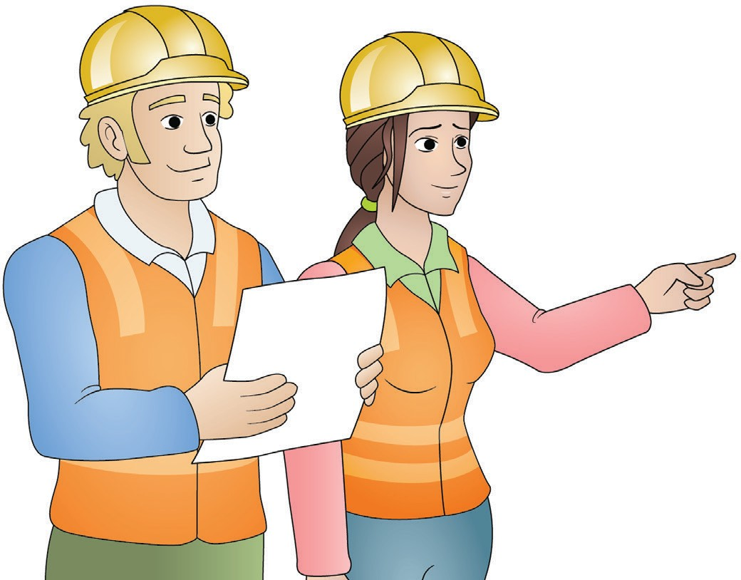
Plan and prepare for belly dump truck operations
Element 1

Slide 8
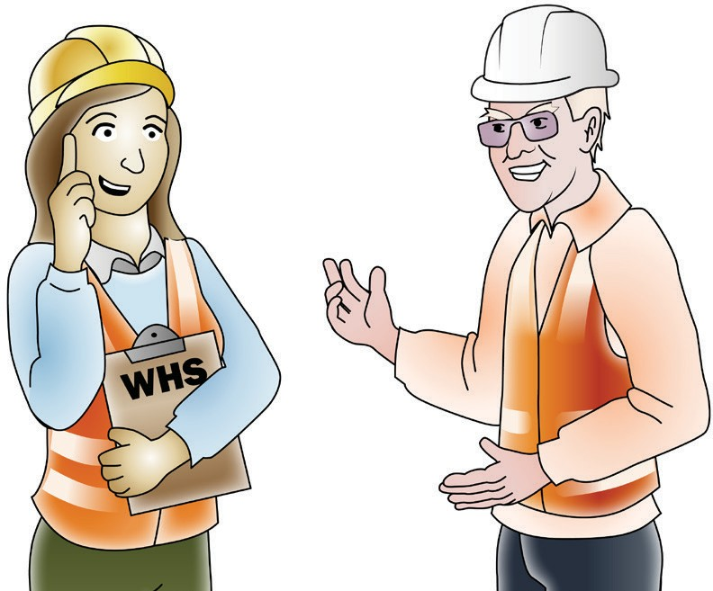
Work Health & Safety Legislative Requirements
PC 1.1 PLAN AND PREPARE FOR BELLY DUMP TRUCK OPERATIONS
‘Laws to keep your workplace safe’
WHS/OHS requirements are outlined in Acts, Regulations, Codes of Practice and Australian Standards.
WHS/OHS Acts
‘WHS/OHS Acts’ are laws that explain how to improve health and safety in the workplace.
For example: Model National WHS Act, June 2011. WHS has the same meaning as OHS in this document.
Regulations
‘Regulations’ explain specific parts of the Act.
For example: Part 4.3 – Confined spaces, Part 4.4 – Falls.
Codes of Practice/Compliance Codes
‘Codes of Practice’ are practical guidelines on how to comply with (meet the rules of) legislation. For example: HAZARDOUS MANUAL TASKS Code of Practice, 23rd December 2011.
Australian Standards
‘Australian Standards’ are work guidelines that set the minimum accepted performance or quality
for a specific hazard, process or product.
For example: AS 2550 – Cranes, hoists and winches – safe use set.

Slide 9
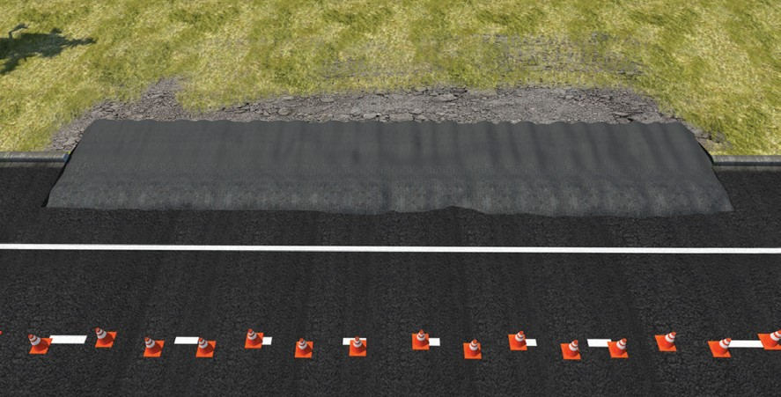
Calculations
PC 1.2 PLAN AND PREPARE FOR BELLY DUMP TRUCK OPERATIONS
Working out how much material you need
The work plan has an area which is 4 metres × 20 metres that must be covered by a layer of road base of 150 mm depth.
How many square metres of road base are to be laid? How many cubic metres of road base will you need?
Step 1:
Work out the square metres
To work out the square metres, multiply the Length (L) by the Width (W).
L × W = Square metres
4 m × 20 m = 80 square metres
This can also be written as: 80 m² or 80 square metres
Step 2:
Convert millimetre thickness to metres
Convert the layer thickness from millimetres to metres.
To do this divide the layer thickness by 1000
150 mm ÷ 1000 = 0.15 m
Step 3:
Work out the square metres
Multiply the square metres by the layer thickness to get the cubic metres.
80 square metres × 0.15 metres
= 12 cubic metres
This can also be written as: 12 m³ or 12 cubic metres
Answer:
There are 80 square metres of road base to be laid.
You will need 12 cubic metres to cover the area to 150 mm depth.

Slide 10
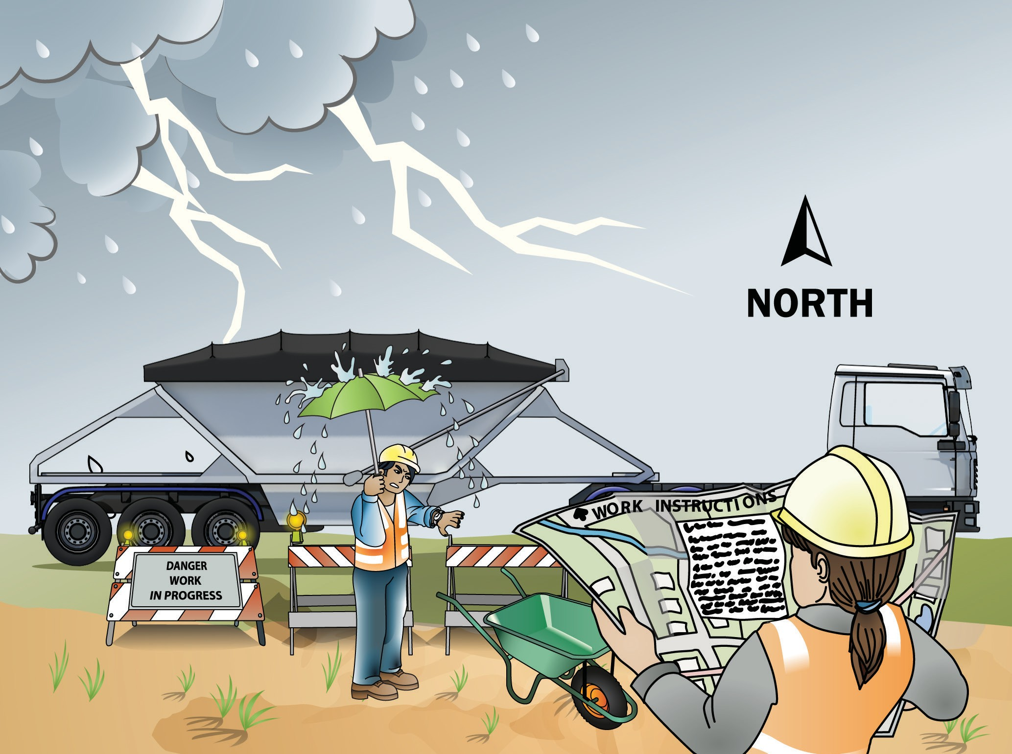
PC 1.2 PLAN AND PREPARE FOR BELLY DUMP TRUCK OPERATIONS
QUESTION 11
What do the job’s work instructions explain?
Work instructions explain:
What to do in unexpected situations like bad weather
What the job is
Where the job is
How to do the job safely
How long the job will take
What tools and equipment you need
How to do the job from start to finish

Slide 11
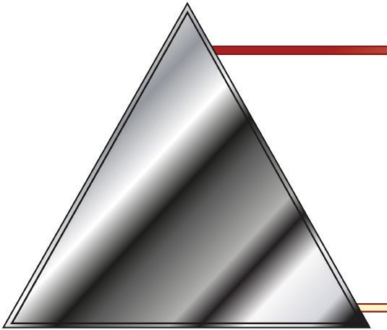
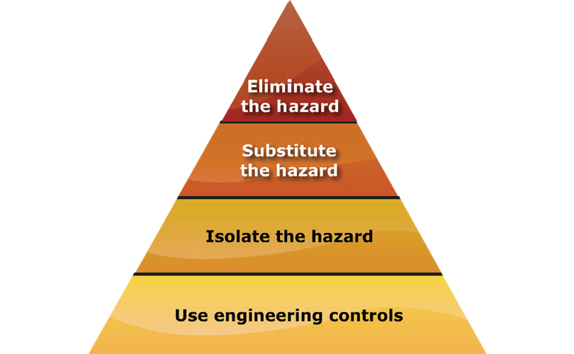
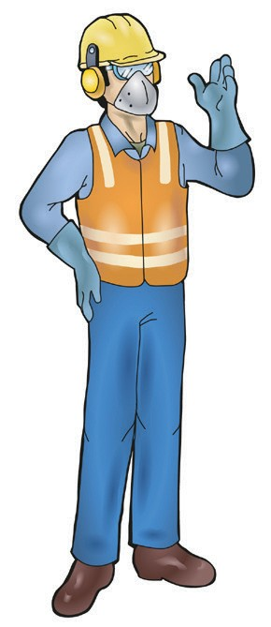
PC 1.3 PLAN AND PREPARE FOR BELLY DUMP TRUCK OPERATIONS
QUESTION 13
The hierarchy of hazard control is a list of controls you can use to lower the danger from a hazard on the worksite.
What are the six (6) levels in the hierarchy of hazard control from the first choice to the last choice?
1. Elimination: If possible, remove (take away)
the hazard.
2. Substitution: Use a safer method if you can’t remove the hazard.
3. Isolation: Stop access to the hazardous (dangerous) area.
4. Engineering Control Measures:
Change the tools, equipment or environment to make it safer.
5. Administrative Practices: Reduce the time the worker is exposed to the hazards by using training, job rotation, the timing of jobs, etc.
6. Personal Protective Equipment (PPE): Use PPE as your last line of defence.
Memory aid: Every Saturday I Eat A Pie

Slide 12
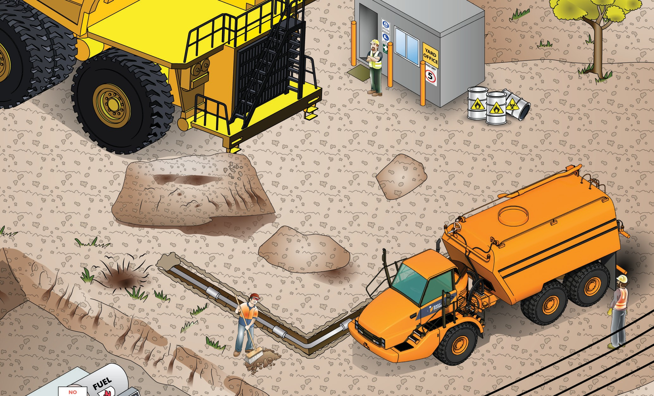
PC 1.3 PLAN AND PREPARE FOR BELLY DUMP TRUCK OPERATIONS
QUESTION 23
What are some hazards you must look for before starting work?
Buildings
Other people
Dangerous materials (chemicals, gasses, acids, explosives)
Bridges
Trees
Uneven or unstable ground
Other vehicles, machines or equipment
Embankments
Hidden holes
Trenches
Powerlines
Things that might get in your way
Drop offs
Underground services (gas, water, electricity, communications)

Slide 13
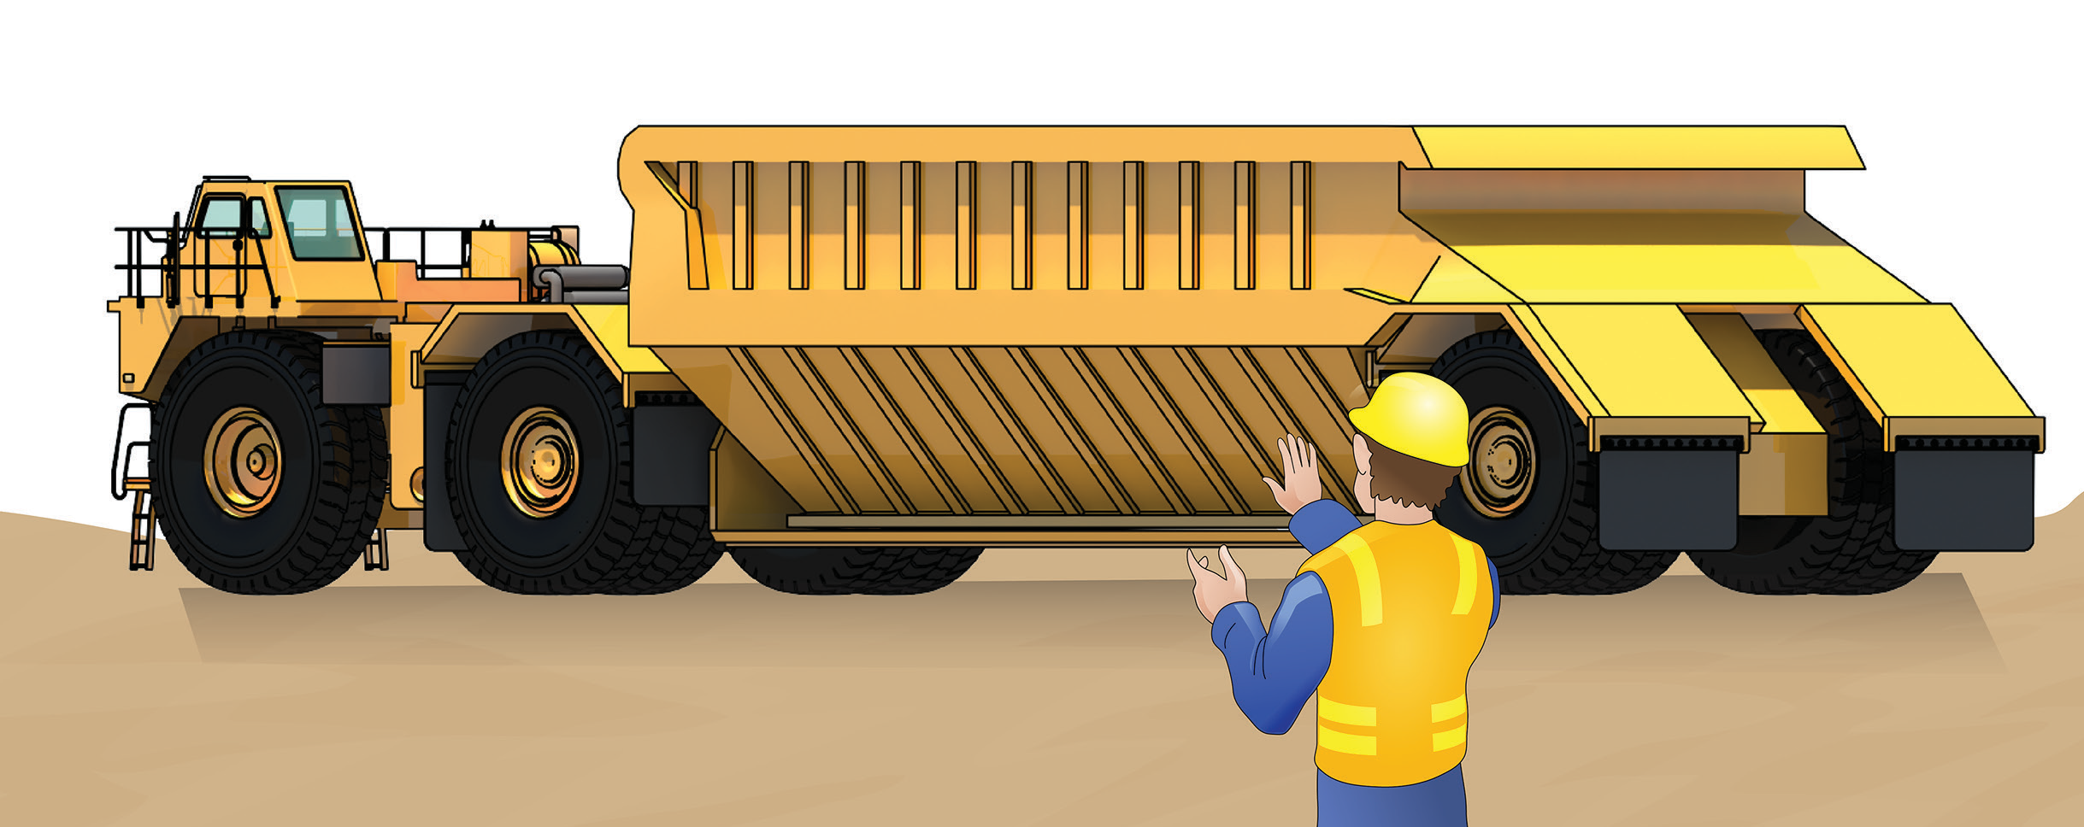
Operate belly dump truck
Element 2

Slide 14
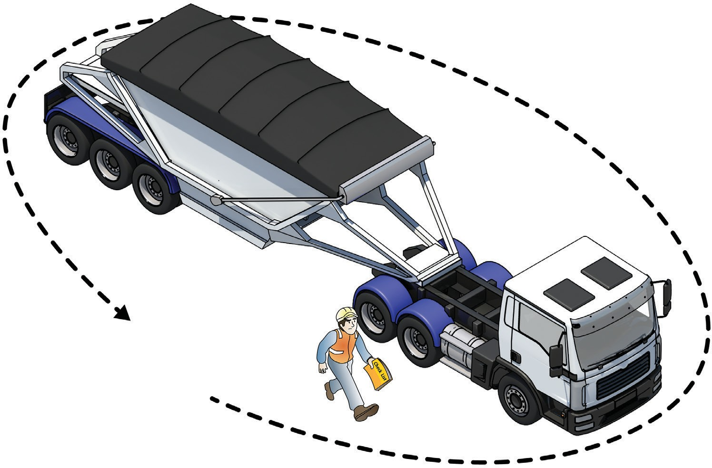
PC 2.1 OPERATE BELLY DUMP TRUCK
QUESTION 43
What is the first check you
do on the machine?
Walk around it and check for obvious problems you can easily see.

Slide 15
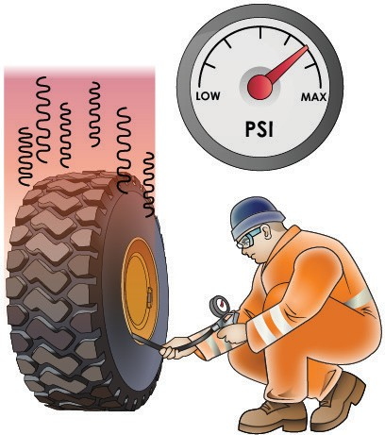
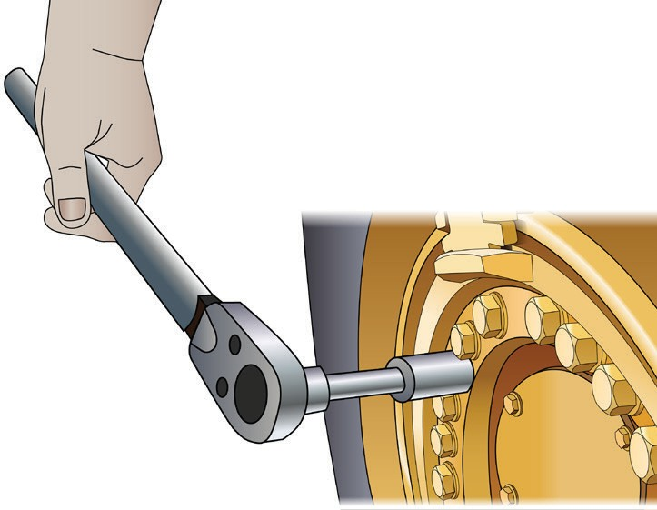
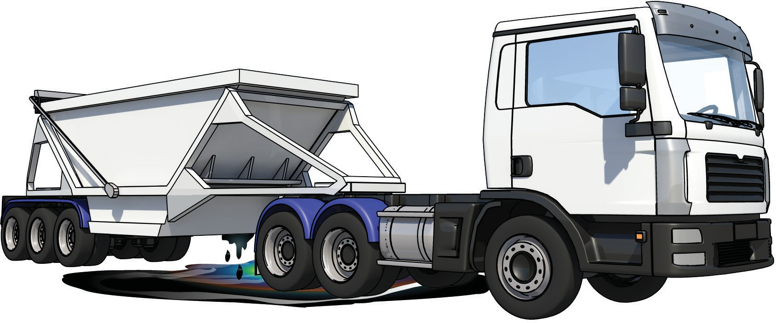
PC 2.1 OPERATE BELLY DUMP TRUCK
QUESTION 44 What are some pre-operational checks you do before using the belly dump truck? | Tyre condition, tyre pressure and wheel nuts
Note: On some mine sites, an authorised mechanic will do some of these checks. | Look for leaks under the machine
 | ...CONTINUES ON NEXT SLIDE

Slide 16
Load, haul dump materials
Element 3

Slide 17
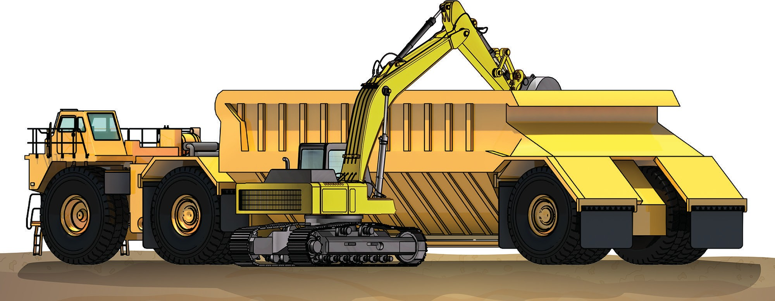
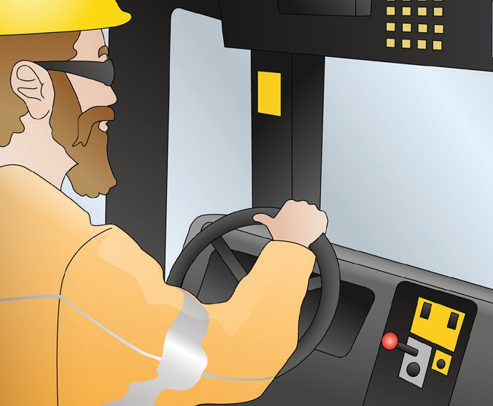
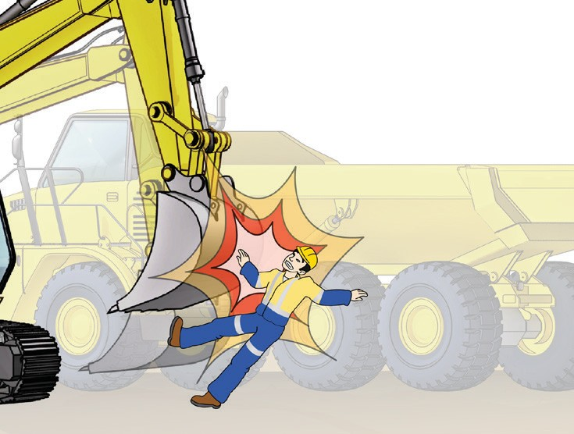
PC 3.1 LOAD, HAUL AND DUMP MATERIALS
QUESTION 84 Why is it important to position the belly dump truck in a good position for loading? | So the loading equipment can load the belly dump truck as quickly as possible. It's also safer.
QUESTION 85 Why should you stay in the belly dump truck’s cabin while it’s being loaded? | You must stay in the cabin so the person loading the truck knows where you are. If you stand outside the truck you could be hit and injured if the load spills on to you.

Slide 18
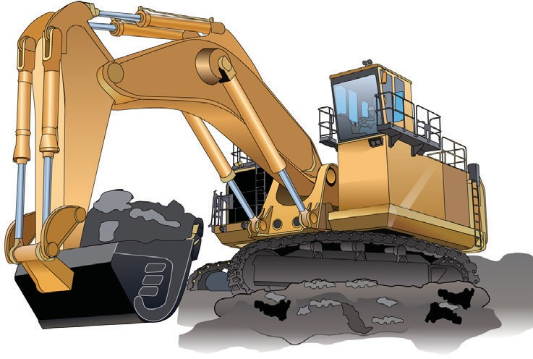
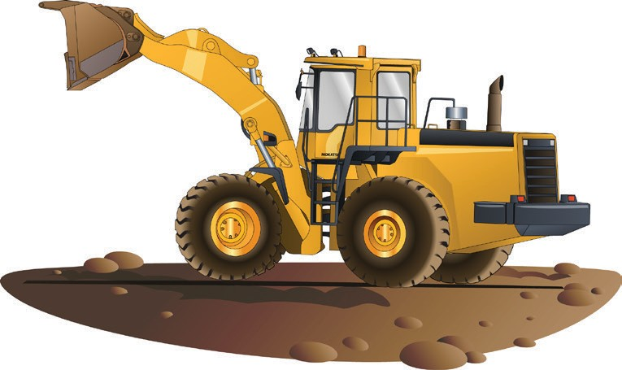
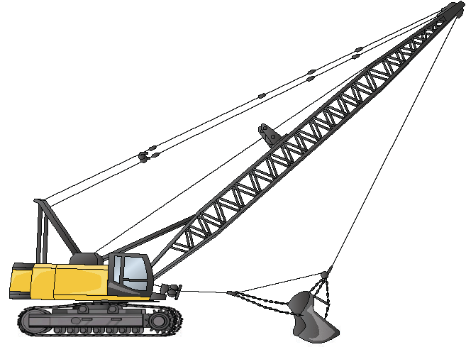
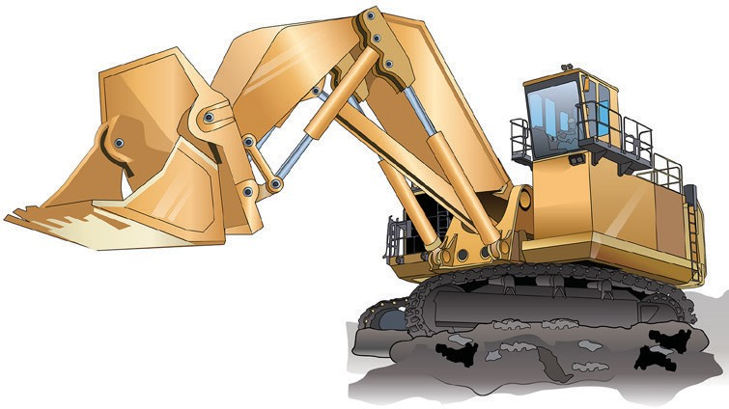
PC 3.1 LOAD, HAUL AND DUMP MATERIALS
QUESTION 86
What kinds of loading equipment might you use to load a belly dump truck?
You might load a belly dump truck with:
Excavators | Loaders
Face shovels | Draglines

Slide 19
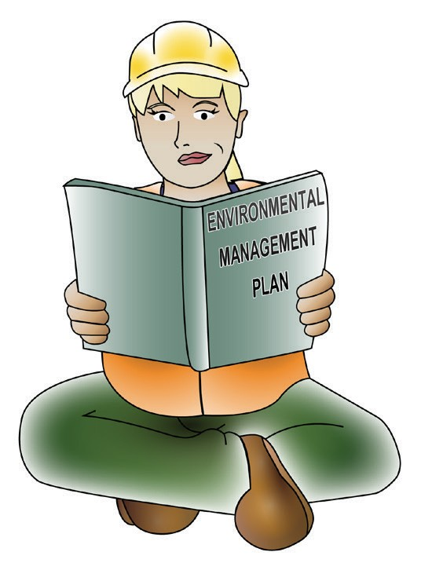
Conduct housekeeping activities
LOAD, HAUL AND DUMP MATERIALS
Chapter 4

Slide 20
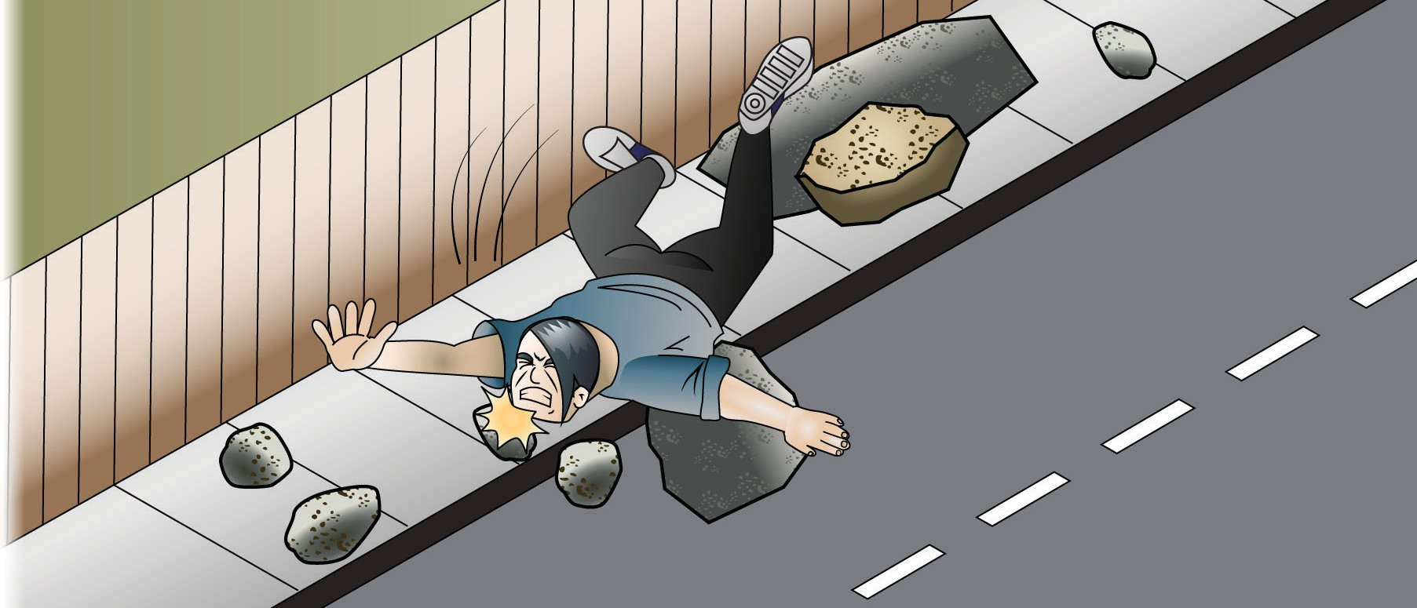
PC 4.1, 4.2, 4.3 CONDUCT HOUSEKEEPING ACTIVITIES
QUESTION 101 What instructions do you follow when cleaning up? | The environmental management plan and site procedures.
QUESTION 102 What is the danger of leaving earth and rocks around the work site? | Someone might trip on a rock and be injured. Rocks left on the road can damage cars.

Slide 21
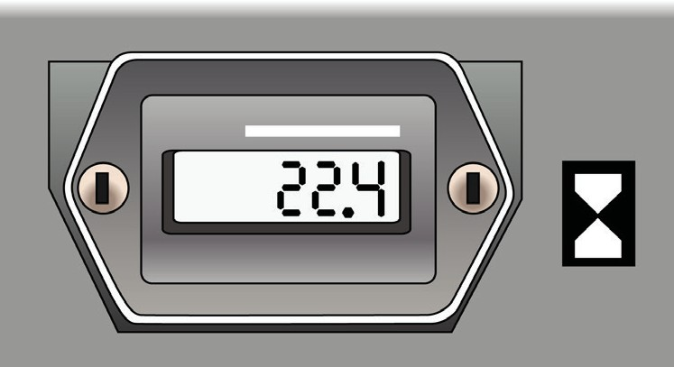
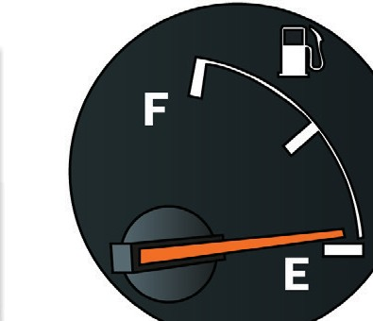
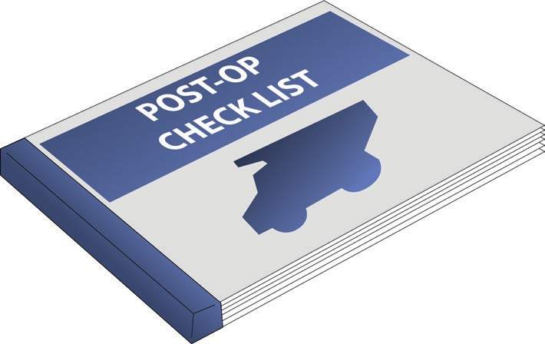
PC 4.3 CONDUCT HOUSEKEEPING ACTIVITIES
QUESTION 104
After you've finished using the haul truck, what records do you need to update?
How much fuel the truck used
Computer readouts, for example, the hour meter
End of shift documents, for example, a checklist of post-operational checks
Which supplies you used and what might need to be replaced
Work logs – for example, record which work plan you were following
Quality requirements, to prove that you did the job properly
Where and when you used the truck
Record any faults in the logbook.

