Slide 1
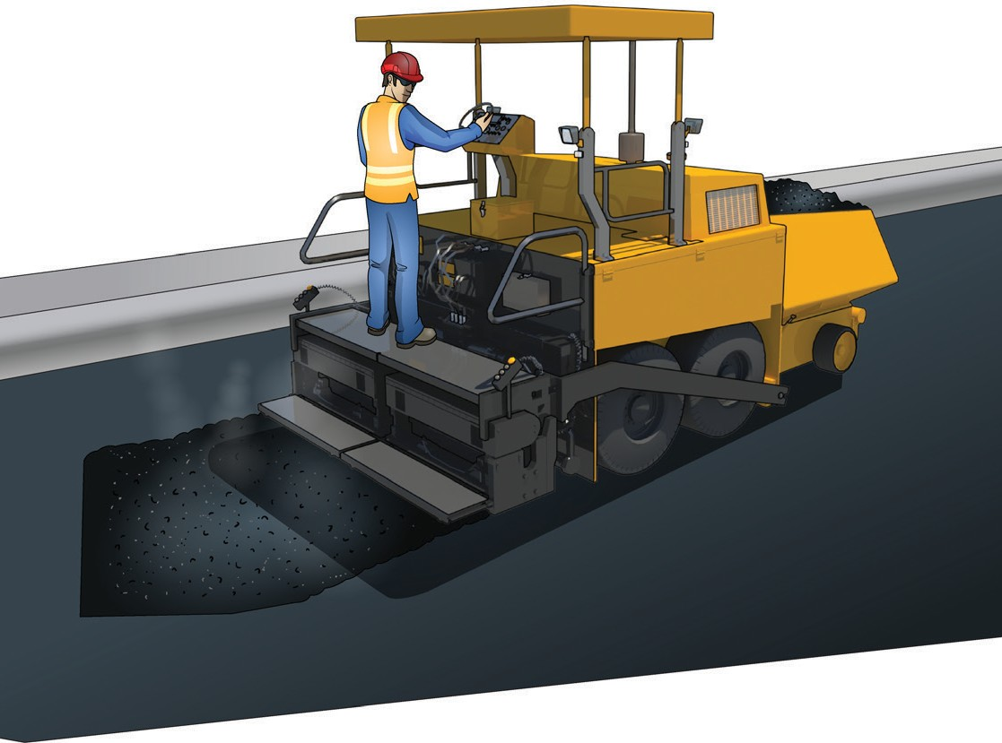
LEARNER GUIDE
Asphalt paver
TICKET
Training support material for:
RIICBS305E
Conduct asphalt paver operations
Produced by:

Slide 2
Contents
Language – Literacy – Numeracy (LLN) Introduction to asphalt pavers
The basics of road construction
6
9
17
25
71
79
91
95
99
Element 1
Element 2
Element 3
Element 4
Element 5
Element 6
Prepare to conduct asphalt paver operations Set up asphalt paver
Operate asphalt paver
Carry out operator maintenance Relocate paver
Clean up

Slide 3
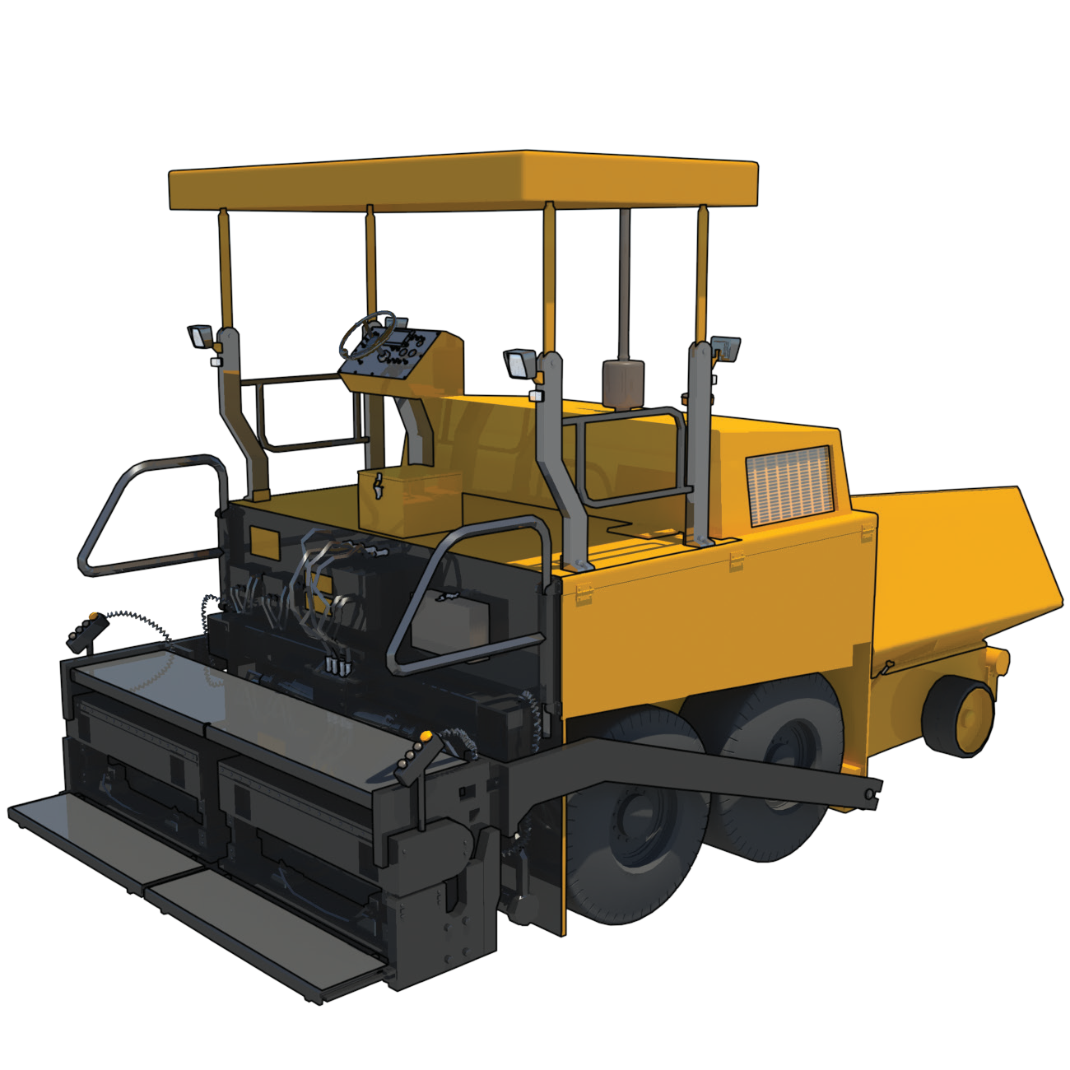
Introduction to aphalt pavers

Slide 4
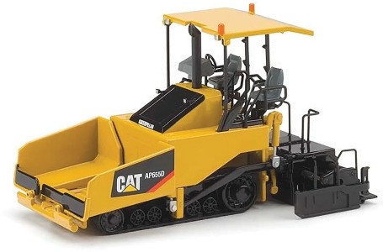
Introduction to asphalt paver
INTRODUCTION TO ASPHALT PAVER
An asphalt paver is a machine used in road construction to distribute and lay hot asphalt onto surfaces. It spreads the asphalt evenly and compacts it to create smooth and durable roads, parking lots, or other paved areas, ensuring proper alignment and thickness for a quality finished surface.
What industries do you use a self-propelled compactor in?
Civil construction

Slide 5
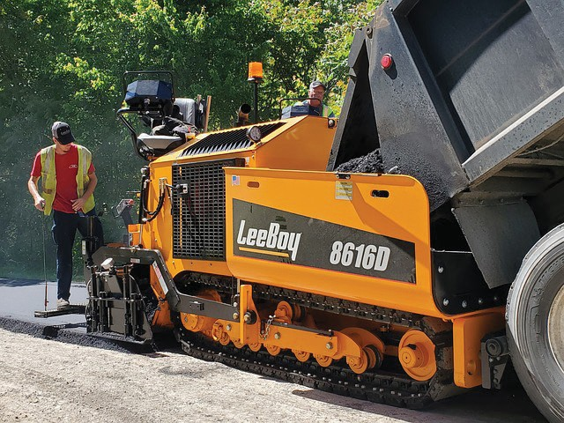
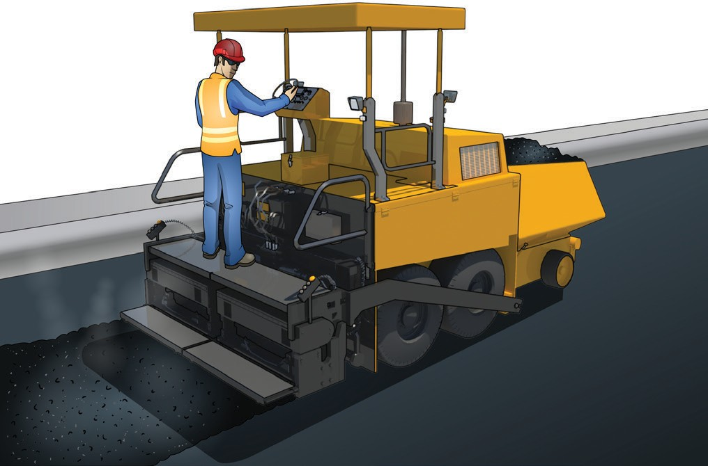
Types of asphalt pavers
INTRODUCTION TO ASPHALT PAVER
Track Pavers:
Wheeled Pavers:
These pavers have tracks instead of wheels, providing better traction and stability on uneven or soft surfaces. They are suitable for large-scale paving jobs and offer excellent maneuverability.
Wheeled pavers have rubber tyres, making them more manoeuvrable and suitable for smaller paving projects or areas with minimal space. They are typically faster to transport between job sites.
(Continued on next page...)

Slide 6
Prepare to conduct asphalt
paver operations
Element 1

Slide 7
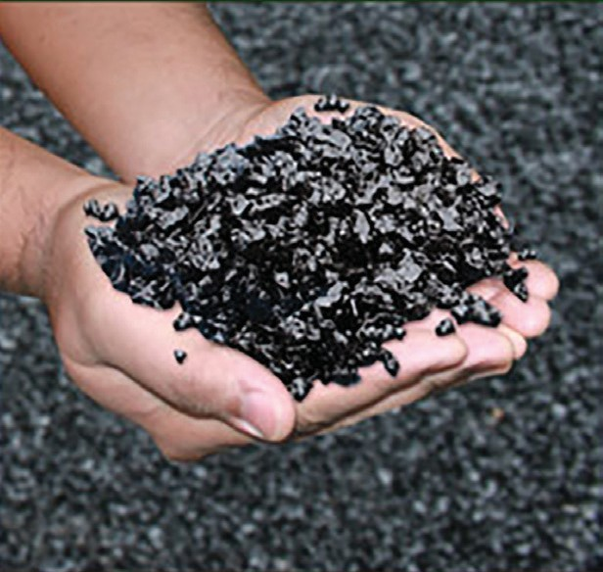
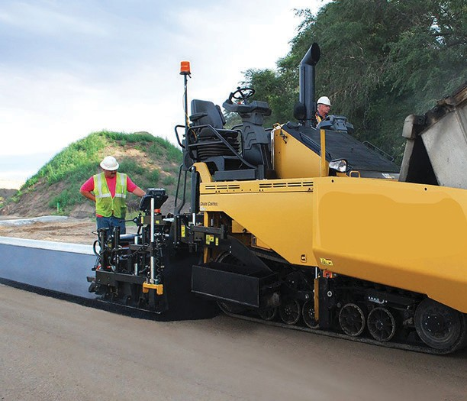
PC 1.1, 1.2 PREPARE TO CONDUCT ASPHALT PAVER OPERATIONS
Question 1. What is the process for calculating material requirements, mix, application rates, uniformity and travel speed when asphalt paving?
Material requirements: Calculate the volume of asphalt needed based on the area
and desired thickness, considering compaction and wastage factors.
Asphalt mix: Consult with experts to determine the appropriate mix design for your
project, considering traffic load and climate conditions.
Application rates: Determine the amount of asphalt to be applied per unit area
based on the mix design, desired thickness, and compaction requirements.
Uniformity: Ensure consistent application rates, equipment calibration, and skilled
operators to achieve a smooth and uniform asphalt surface.
Travel speed: Determine the optimal speed at which the paving equipment should travel, considering factors such as the asphalt mix, temperature, and compaction requirements.
Remember to seek guidance from paving professionals, engineers, or asphalt
suppliers for accurate calculations and tailored advice for your specific project.

Slide 8
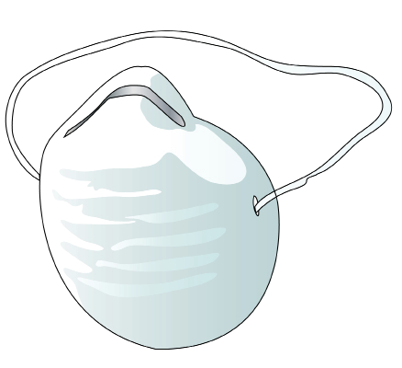
PC 1.4 PREPARE TO CONDUCT ASPHALT PAVER OPERATIONS
Question 13. What PPE should you use when working with an asphalt paver?
Following are examples of PPE you might need to use when using an asphalt paver:
Hard hat
Hi-vis vest
Dust mask
Safety gloves
Long sleeved top
Ear muffs
Boots that cover the whole foot
Safety glasses/goggles, Sunglasses
Long pants
Sunscreen

Slide 9
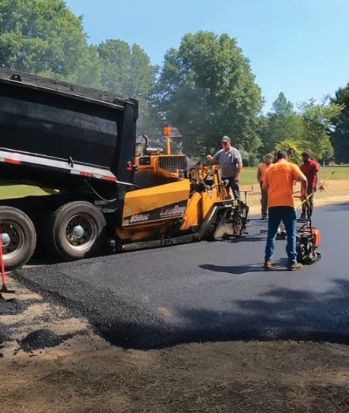
PC 1.6 PREPARE TO CONDUCT ASPHALT PAVER OPERATIONS
Question 24. How do you find out what material needs to be laid?
To determine the material that needs to be laid when working with an asphalt
paver, you typically follow these steps:
Consult project specifications: Review the project documents, including plans, drawings, and specifications provided by the client, engineering team, or project manager. These documents outline the type and thickness of the asphalt mix to be used.
Communicate with the project team: Talk to the project team, including engineers, supervisors, or foremen responsible for the project. They can provide specific instructions regarding the asphalt mix requirements, including gradation, binder type, additives, or any special considerations.
Follow construction contracts or guidelines: Refer to construction contracts, industry standards, or local guidelines that may outline the asphalt mix specifications for the specific project. These documents often provide detailed information about the desired material properties and performance criteria.
Coordinate with suppliers or asphalt plants: Collaborate with asphalt suppliers or plants responsible for producing the asphalt mix. Communicate the project requirements, including the desired mix design, to ensure that the appropriate material is delivered to the work site.
Conduct on-site testing or sampling: In some cases, on-site testing or sampling may be necessary to verify the properties of the existing pavement or the material needed for resurfacing. Testing methods, such as coring or extraction, can provide information about the existing pavement layers and help determine the appropriate asphalt mix to be used.

Slide 10
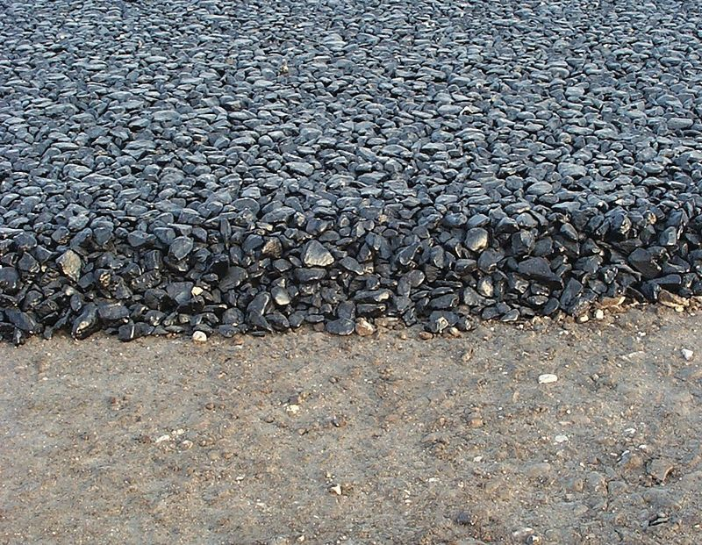
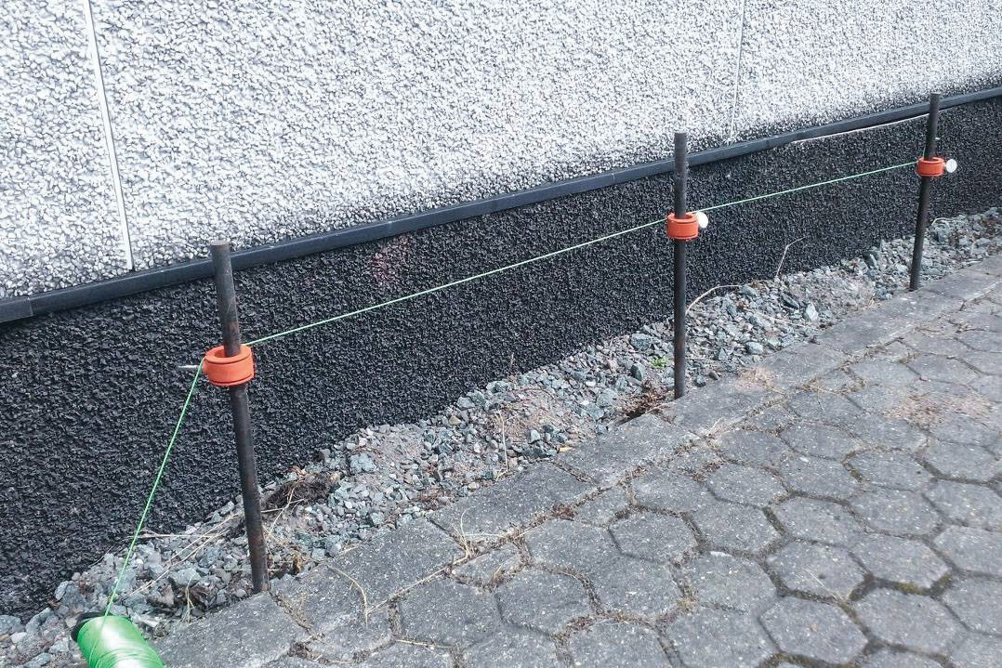
PC 1.6 PREPARE TO CONDUCT ASPHALT PAVER OPERATIONS
Question 25. How do you prepare the material to be handled and laid when working with an asphalt paver?
Prepare the paver: Make sure that the asphalt paver is in good working condition and properly calibrated. Check that all components, such as the screed, augers, and conveyors, are clean, lubricated, and functioning correctly.
Receive the asphalt mix: Coordinate with the asphalt supplier or plant to receive the appropriate material at the work site. Communicate the desired mix design and any specific requirements.
Inspect the material: Before laying the asphalt, visually inspect the material to ensure it meets the specified requirements. Verify the temperature of the mix and check for any signs of contamination or irregularities.
Establish a paving plan: Plan the paving process, considering factors like the width and thickness of the desired pavement, joint locations, and any special considerations mentioned in the project specifications.
Position the paver: Position the asphalt paver at the starting point of the paving area. Ensure that it is aligned correctly with the reference marks or string lines.

Slide 11
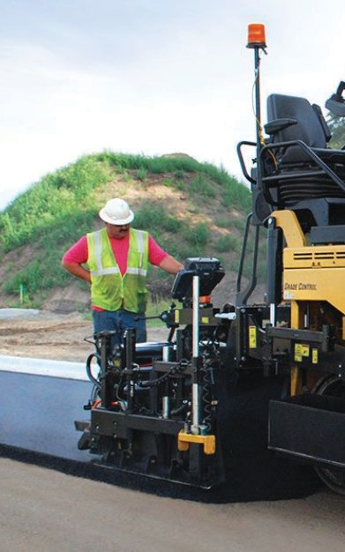
PC 1.7 PREPARE TO CONDUCT ASPHALT PAVER OPERATIONS
Question 27. What faults on tools and equipment should you check for?
Damage or Wear: Check for cracks, bends, or excessive wear on tools
that could affect their performance or structural integrity.
Proper Functioning: Ensure that tools operate smoothly, have secure
fastenings, and functional mechanisms.
Blade or Edge Condition: Examine cutting or spreading tools for
sharpness and intact blades or edges.
Handle Integrity: Inspect handles or grips for stability, firm attachment, and freedom from cracks or breaks.
Cleanliness: Remove built-up asphalt or debris from tools to maintain
performance and prevent contamination.
Lubrication: Apply appropriate lubrication to tools with moving parts to
ensure smooth operation and prevent rust or corrosion.
Calibration (for measuring tools): Verify the calibration of measuring tools for accurate readings and precise asphalt placement.
Safety Features: Check the integrity and functionality of safety features such as guards or safety locks to prevent accidents or injuries.
Check calibration.

Slide 12
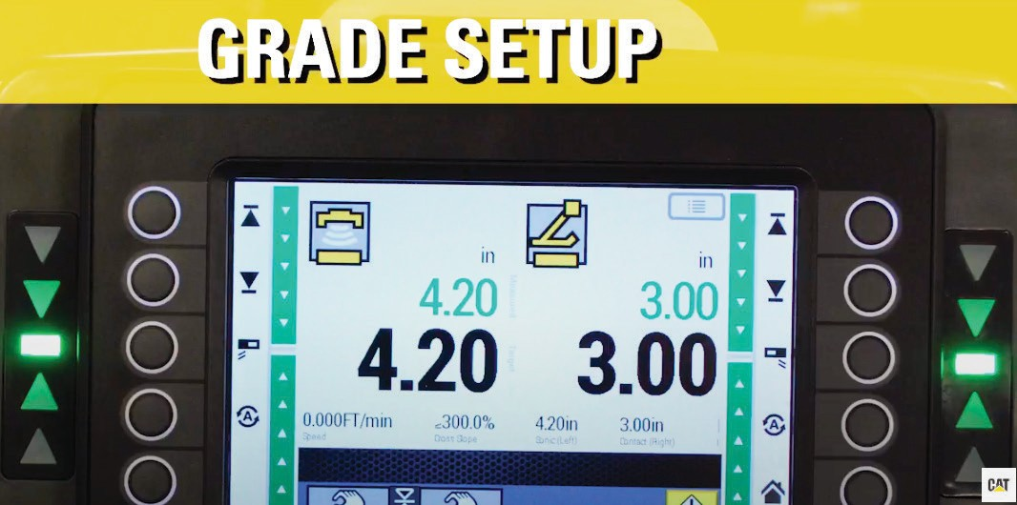
Set up asphalt paver
Element 2

Slide 13
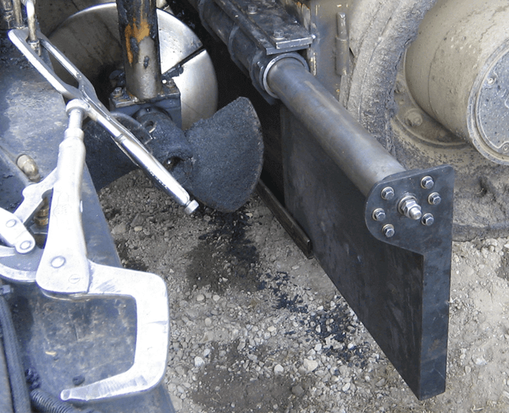
PC 2.1 SET UP ASPHALT PAVER
Question 29. What are some examples of start up procedures when operating an asphalt paver?
Pre-Operation Inspection:
Visually inspect the paver for damage and check fluid levels. Make sure safety guards are in place and secure.
Check safety devices and emergency stop buttons.
Start the Engine:
Start the engine. Allow engine to warm up as recommended.
System Check and Calibration:
Verify control system functionality.
Calibrate the grade control system if needed.
auger and screed
Warm-up and System Testing:
Warm up tracks/tyres and test conveyor and auger systems. Test screed functions and heating elements.
Check control system

Slide 14
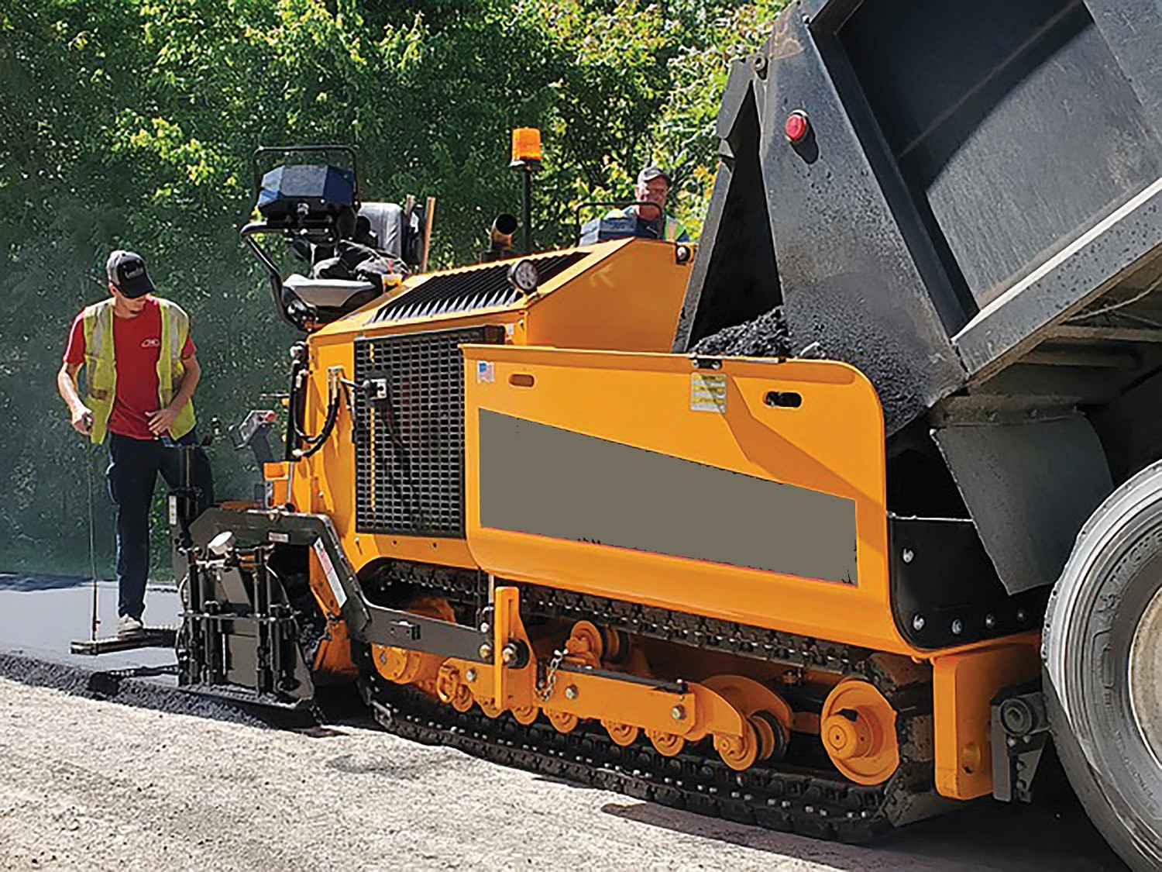
Operate asphalt paver
Element 3

Slide 15
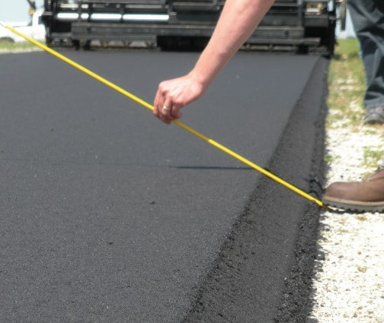
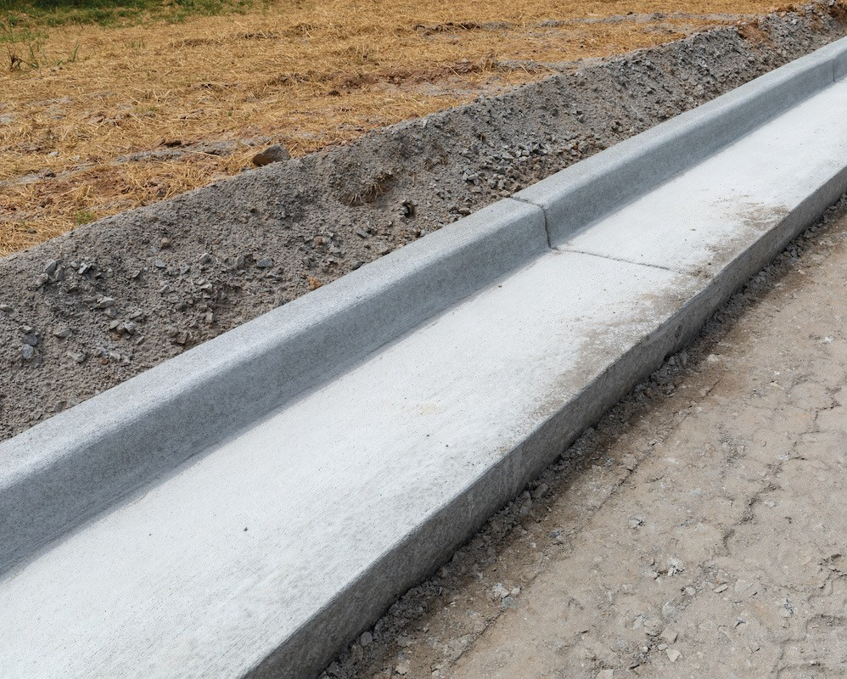
PC 3.1 OPERATE ASPHALT PAVER
Question 37. What are edge treatments when using an asphalt paver?
Edge and joint treatments are important aspects of asphalt paving that help ensure the integrity and longevity of the pavement. Here's a concise explanation of edge and joint treatments in asphalt paving:
Edge Treatments: Edge treatments refer to the methods used to reinforce and protect the edges of an asphalt pavement. The edges of the pavement are typically more vulnerable to cracking and damage due to traffic, water infiltration, and other factors. Common edge treatments include:
Edging and compaction: The edges of the asphalt are compacted
and shaped to create a smooth transition between the pavement and adjacent surfaces like curbs or gutters. This helps prevent water intrusion and ensures a stable edge.
Joint sealants: Sealants are applied to the edges of the asphalt pavement to protect against moisture penetration, which can lead to cracking and deterioration. Sealants help maintain the integrity of the pavement by preventing the intrusion of water, debris, and chemicals.
Reinforcement: In some cases, additional measures like edge reinforcement systems, such as geosynthetic materials or concrete curbs, may be used to enhance the strength and stability of the pavement edges.

Slide 16
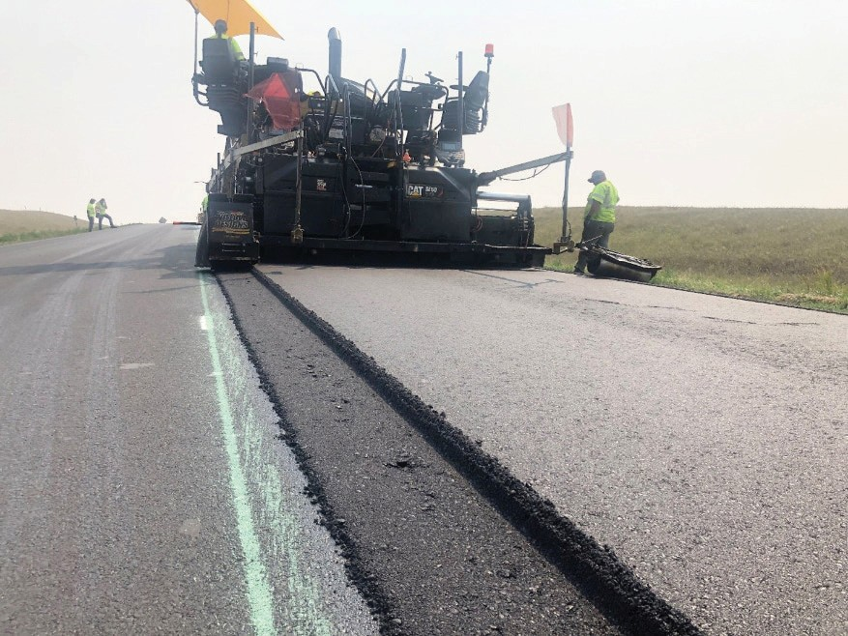
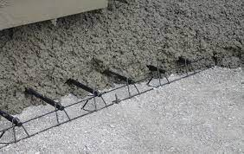
PC 3.1 OPERATE ASPHALT PAVER
Question 38. What are joint treatments when using an asphalt paver?
Joint Treatments: Joints are intentional gaps or seams introduced between adjacent sections of the asphalt pavement to allow for thermal expansion and contraction. Joint treatments help ensure that these gaps are properly filled and sealed to prevent the ingress of water, debris, and other substances. Common joint treatments include:
Joint sealants: Similar to edge treatments, joint sealants are used to
fill the gaps between adjacent sections of the asphalt pavement. They provide a waterproof barrier and help maintain the pavement's structural integrity by preventing the entry of moisture and debris.
Joint reinforcement: In some cases, additional reinforcement measures may be used at the joints to enhance the load transfer and reduce the potential for joint deterioration or faulting. This can include the use of dowel bars, tie bars, or other mechanical devices.
By implementing appropriate edge and joint treatments, asphalt paving projects can minimise the risk of cracking, water damage, and premature pavement failure, thus ensuring the long-term durability and performance of the pavement.

Slide 17
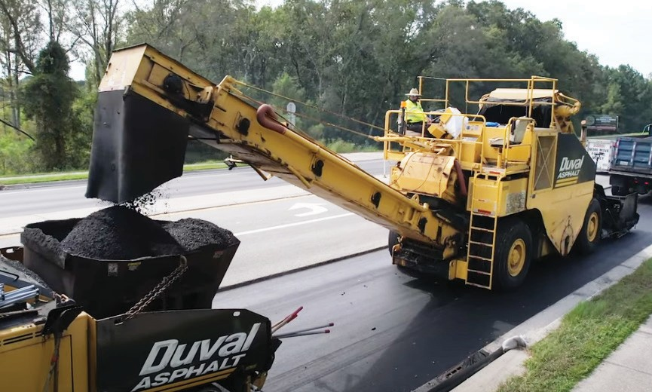
PC 3.2 OPERATE ASPHALT PAVER
Question 40. What is it important to connect to the asphalt delivery vehicle without bumping?
Quality of the asphalt: Bumping or jolting the delivery vehicles can cause the asphalt to become unevenly distributed
within the truck. This can result in variations in the mixture's temperature, density, and composition.
Uniform pavement surface: When the delivery vehicles are engaged smoothly, the asphalt can be evenly spread across
the road surface.
Proper compaction: Bumping or jarring the delivery vehicles can disrupt the compaction process, leading to inadequate
density and air voids within the asphalt.
Worker safety: Smooth engagement of delivery vehicles is crucial for the safety of the workers involved in the paving
process. Sudden bumps or jolts can lead to accidents, causing injuries to workers and damage to equipment.

Slide 18
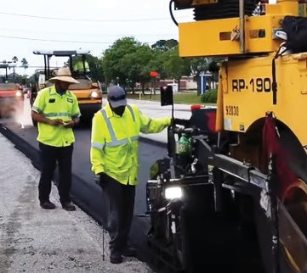
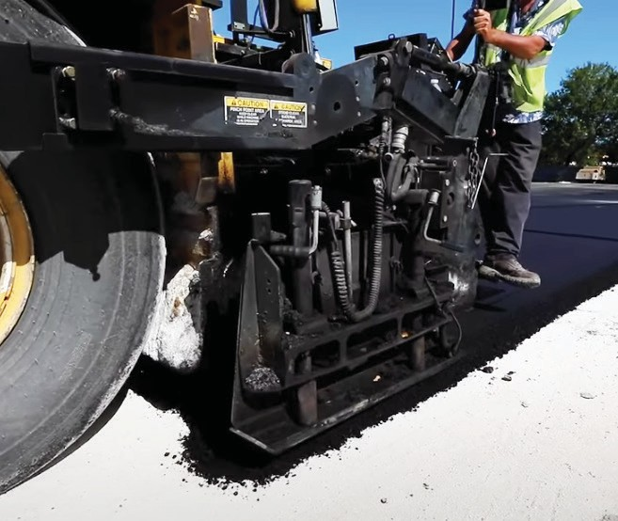
PC 3.4 OPERATE ASPHALT PAVER
Question 42. Why should you check on and maintain the asphalt mix?
Quality control: Regularly checking the asphalt mix ensures that it meets the required specifications and quality standards. This involves monitoring the composition, temperature, and consistency of the mix to ensure it is within the acceptable range.
Optimal performance: Monitoring the mix during paving helps identify any deviations or inconsistencies that could affect its performance, such as inadequate compaction or improper temperature.
Uniformity and smoothness: Maintaining the asphalt mix helps achieve a
uniform surface and smooth ride for motorists.
Longevity and durability: The quality of the asphalt mix directly impacts the durability and longevity of the road. By closely monitoring the mix during paving, you can identify and address any issues promptly. This includes verifying the correct aggregate gradation, asphalt binder content, and appropriate temperature during installation.
Cost savings: Regularly checking and maintaining the asphalt mix can save costs in the long run. Identifying and addressing any mix-related problems during the paving process helps prevent the need for extensive repairs or premature resurfacing.

Slide 19
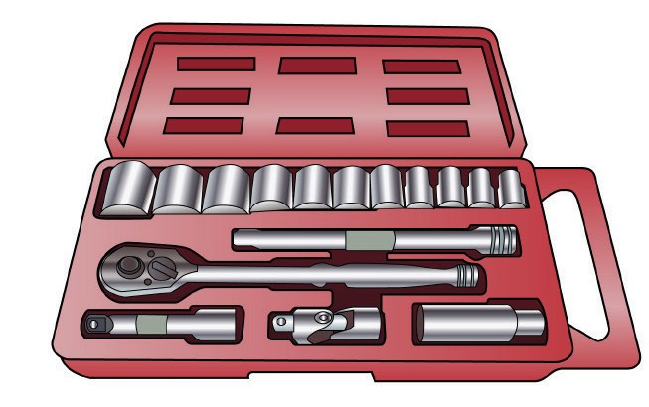
Carry out operator maintenance
Element 4

Slide 20
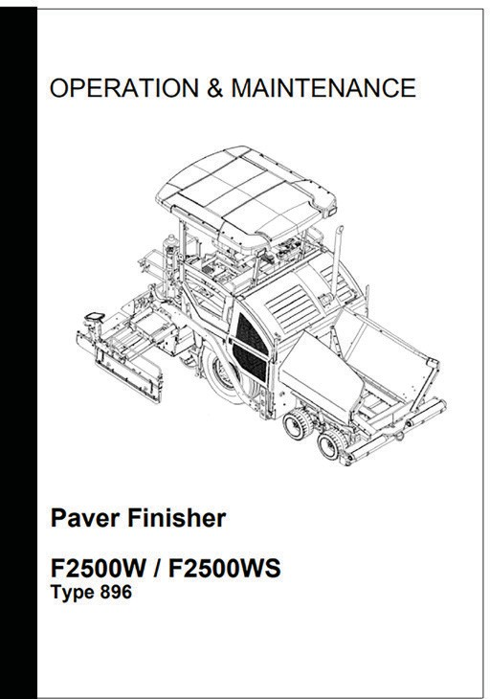
PC 4.1, 4.2 CARRY OUT OPERATOR MAINTENANCE
Question 45. How do you prepare the asphalt paver for maintenance?
Review the manufacturer's guidelines: Familiarise yourself with the specific maintenance requirements and recommendations provided by the manufacturer of the asphalt paver. This information can be found in the equipment manual or maintenance documentation. Follow their guidelines for the best results.
Gather necessary tools and materials: Determine the tools, equipment, and materials required for the maintenance tasks you plan to perform. This may include wrenches, lubricants, cleaning supplies, replacement parts, and safety equipment. Ensure you have everything readily available before beginning the maintenance process.
Shut down and secure the paver: Turn off the paver's engine and any auxiliary systems. Engage the parking brake and ensure the equipment is in a stable position. If applicable, follow any additional safety protocols specific to your paver model.
Perform a visual inspection: Conduct a thorough visual inspection of the paver to identify any obvious signs of wear, damage, or leaks. Check the various components such as the screed, conveyor system, augers, and hydraulic systems. Make a note of any issues or areas that require attention during the maintenance process.

Slide 21
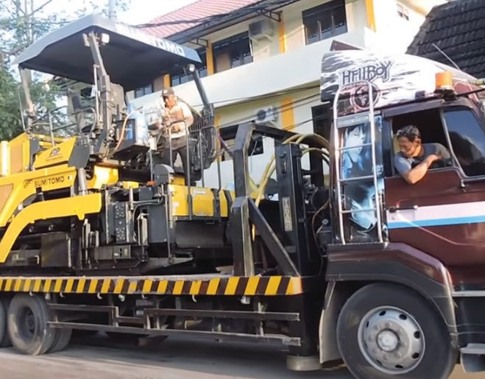
Relocate paver
RELOCATE PAVER
Element 5

Slide 22
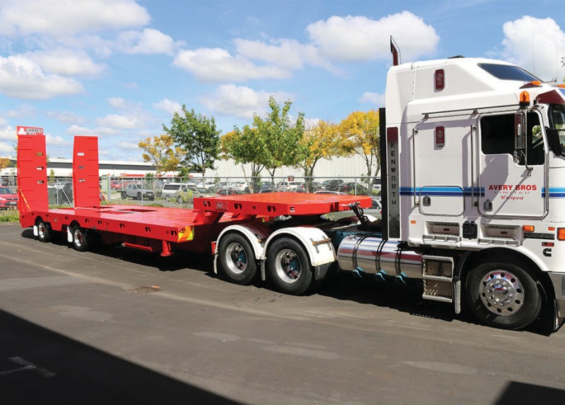
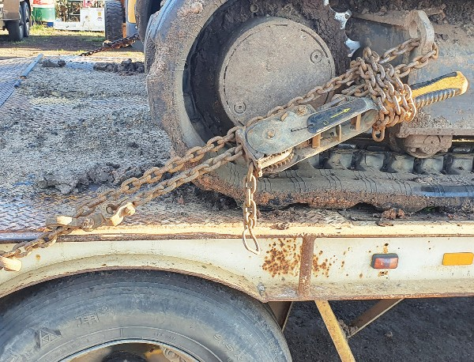
PC 5.1 RELOCATE PAVER
Question 48. How do you prepare the paver for relocation?
Clean the paver thoroughly by removing debris to ensure it's free from any materials that could cause damage during transportation.
Conduct a detailed inspection of the paver to identify any existing damage or mechanical issues, documenting them for reference and potential repairs.
Secure or remove loose parts such as screeds or auxiliary equipment, storing them separately to protect them from damage and ensure easy reinstallation later.
Fold or retract components like screed extensions or conveyor belts to decrease the overall dimensions of the paver, facilitating easier and safer transport.
Fasten the paver securely onto a trailer or transportation vehicle using approved restraints like straps or chains, ensuring even distribution and balanced placement for stability during transit.
Check on any necessary permits specific to the transportation of heavy equipment like the asphalt paver.
Consider engaging professionals experienced in moving heavy machinery if you lack confidence or the required equipment to ensure a safe and smooth relocation process for the asphalt paver.

Slide 23
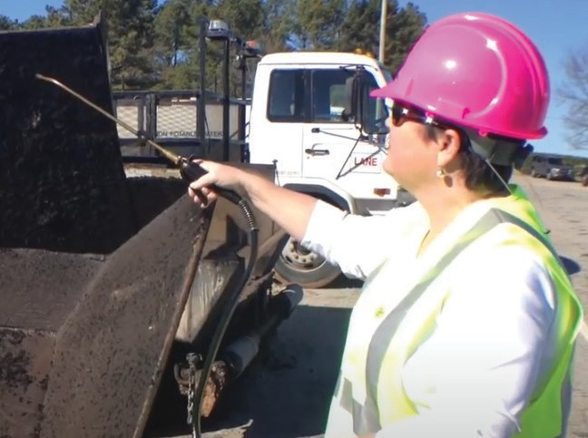
Clean up
RELOCATE PAVER
Element 6

Slide 24
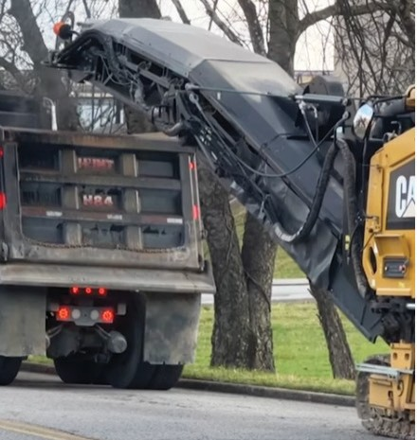
PC 6.1 CLEAN UP
Question 50. How do you clear the work area and dispose of and recycle materials?
Clean the work area: Remove any loose debris, such as rocks, dirt, or vegetation, from the work area. Sweep the area thoroughly to ensure a clean surface.
Collect excess asphalt: If there is any excess asphalt left on the paver or in the hopper, you can use a shovel or rake to gather it and transfer it to a designated storage area. This excess asphalt can often be reused in future projects.
Dispose of waste materials: Any waste materials generated during the paving process, such as used asphalt, broken asphalt pieces, or damaged materials, should be collected and disposed of properly. Check local regulations and guidelines for the appropriate disposal methods in your area.
Separate recyclable materials: Identify recyclable materials like used asphalt, broken asphalt pieces, or reclaimed asphalt pavement (RAP). Separate these materials from non-recyclable waste. RAP can be reused in new asphalt mixes, contributing to sustainability and cost-effectiveness.

Slide 25
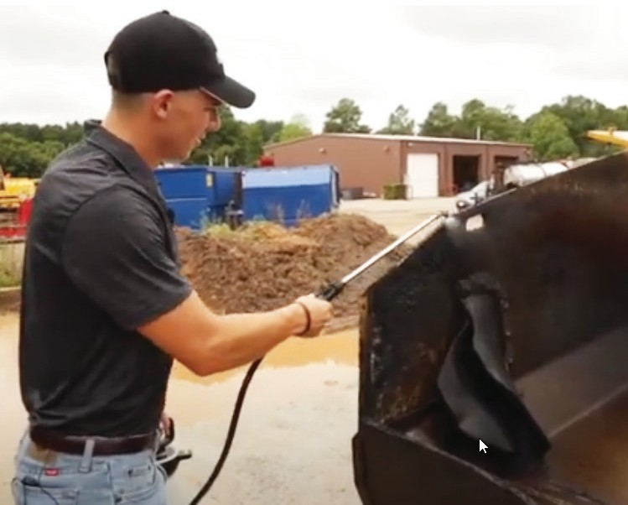
PC 6.2, 6.3 CLEAN UP
Question 54. What what housekeeping might you need to do after using an asphalt paver?
Clearing debris: Remove any loose asphalt, rocks, or other debris from the immediate area around the paver. Use a broom, shovel, or other appropriate tools to clear the work site.
Cleaning the screed: The screed is a critical component of the asphalt paver. After use, it is essential to clean the screed to remove any excess asphalt or material buildup. Use a pressure washer, high-pressure hose, or scraper to remove the debris from the screed plates, augers, and conveyors.
Cleaning the hopper: The hopper is the area where the asphalt mixture is stored before it is spread by the paver. Clear any leftover asphalt from the hopper to prevent contamination in future operations. Use a shovel or other appropriate tools to remove the excess material, and dispose of it properly according to local regulations.
Storing equipment and tools: After use, store all equipment, tools, and accessories in their designated locations. This includes cleaning and properly storing items such as shovels, rakes, brooms, and any other tools used during the paving process.
General maintenance checks: Take this opportunity to conduct basic maintenance checks, such as inspecting the paver for loose bolts or damaged components.

