Slide 1
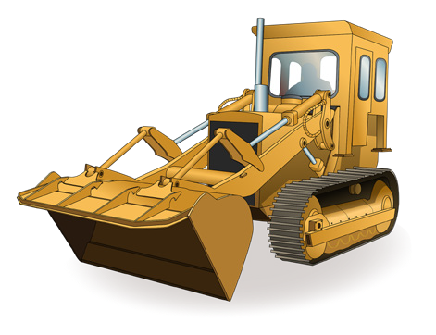
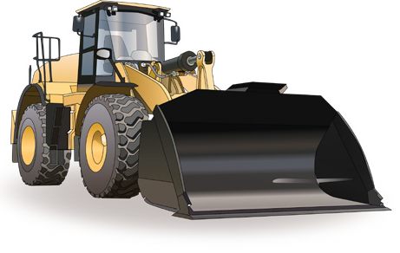
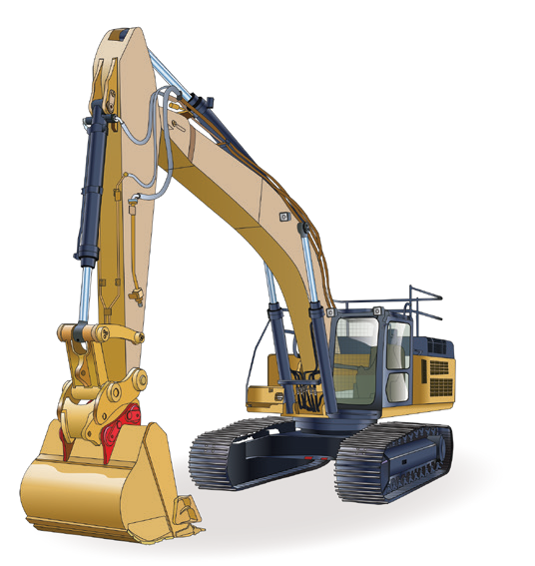
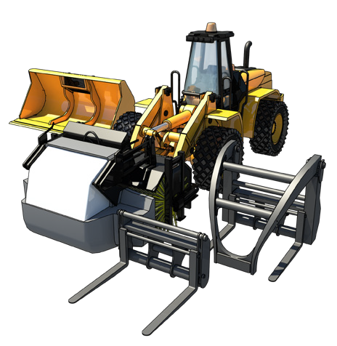
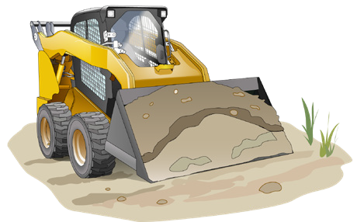
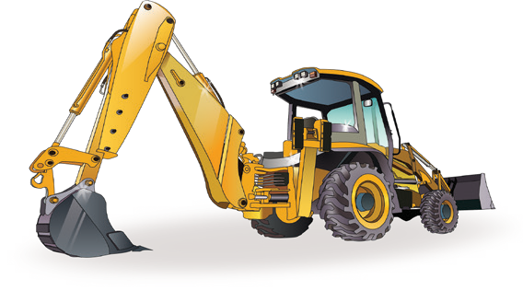
LEARNER GUIDE
Civil Construction
RIIMPO321F
wheeled front end loader
RIIMPO322F
tracked front end loader
RIIMPO318F
skid steer loader
RIIMPO319E
backhoe
RIIMPO320F
excavator
RIIHAN311F
integrated tool carrier

Slide 2
Contents
How to use this guide
Introduction to earthmoving machinery General information
Plan and prepare for work Operate earthmoving machinery Lift, carry and place materials
Select, remove and fit attachments
Relocate the machine
Carry out post operational checks Housekeeping
4
5
19
33
79
115
151
173
187
196

Slide 3
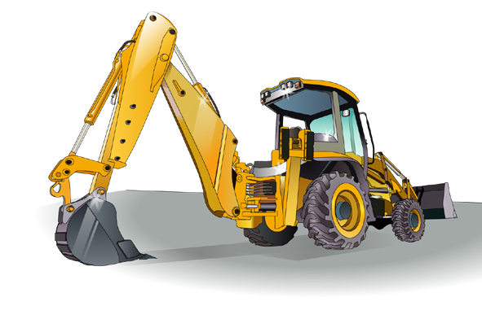
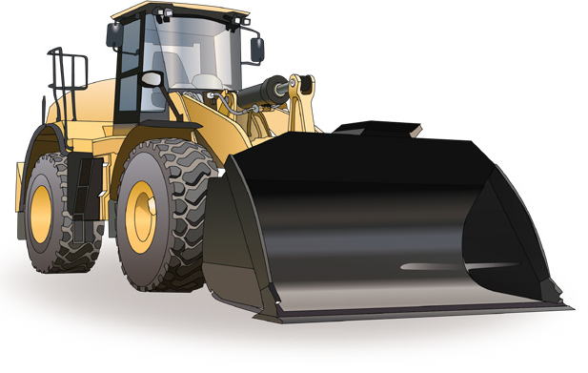
Introduction to earthmoving machinery

Slide 4
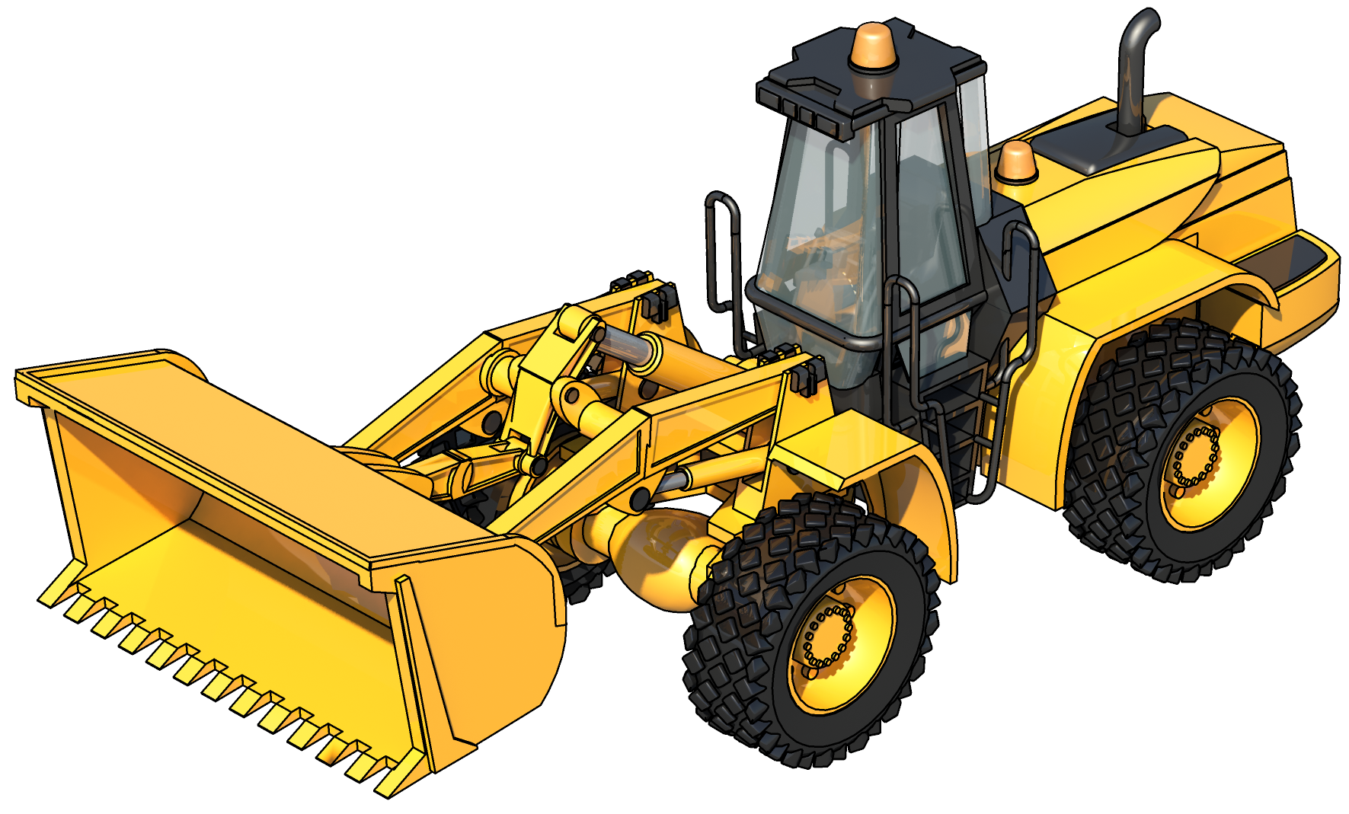
An example of a wheeled front end loader
A wheeled front end loader is a type of machine, that has a front-mounted square wide bucket connected to the end of two booms (arms) to scoop up loose material such as dirt, sand or gravel and move it from one place to another without pushing
the material across the ground.
A wheeled front end loader is commonly used to move material from ground level and deposit it into an awaiting dump truck, stockpile or into an open trench excavation.
Dump cylinder
Tilt link
Bucket
Rear wheel
Lift cylinder
Lift arm
Front wheel

Slide 5
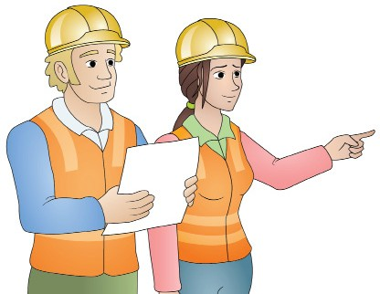
Plan and prepare for work

Slide 6
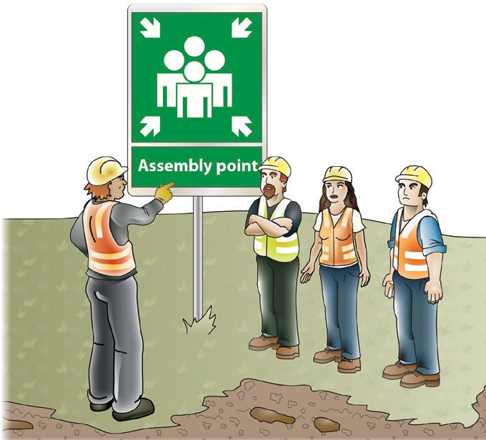
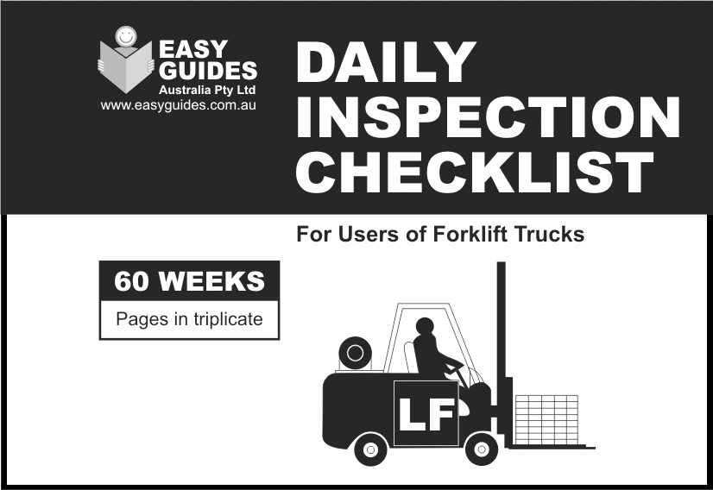
PLAN AND PREPARE FOR WORK
...CONTINUED FROM PREVIOUS PAGE
Emergency procedures: Having documentation on emergency procedures, including evacuation plans and contact information for emergency services, is crucial in case of accidents or unexpected events.
Daily inspection checklists: Operators should conduct daily inspections of the machinery before use. Documentation of these inspections can help identify potential issues early and ensure safe operation.
Work plans and project documentation: If you are using earthmoving machinery as part of a larger project, you may need documentation related to the project plan, scope of work, and any relevant permits or approvals.
Emergency procedures: Having documentation on emergency procedures, including evacuation plans and contact information for emergency services, is crucial in case of accidents or unexpected events.
Daily inspection checklists: Operators should conduct daily inspections of the machinery before use. Documentation of these inspections can help identify potential issues early and ensure safe operation.
Fuel and usage logs: Keeping track of fuel consumption and equipment usage can be essential for cost management and maintenance planning.
Manufacturer's specifications: It's important to have access to the machinery's specifications, including load capacity, operating limitations, and safety features.
Incident and accident reports: In case of accidents or incidents involving the machinery, you should document the details, including the date, time, location, and any injuries or damages. This information may be required for insurance claims or regulatory reporting.
Have an emergency evacuation plan.
Check your machine every day.

Slide 7
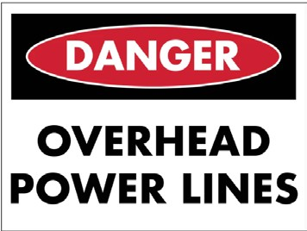
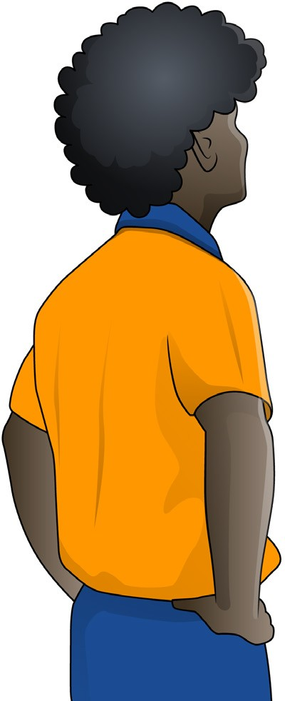
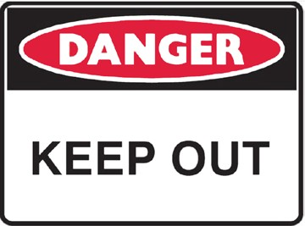
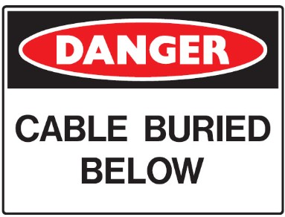
Identifying workplace hazards
PLAN AND PREPARE FOR WORK
Above head height
You should check above eye level for:
Powerlines
Buildings
Trees
Other obstructions.
A hazard is anything that can harm you or others while you are working. The first thing you need to do is to identify these hazards before you start work.
Take a good look at your workplace and decide if anything could possibly cause injury to you or anyone else in the area.
Ground to eye height
You should check around eye height for:
Other equipment
Machinery
People
Pedestrians
Things in the path of travel
Other obstructions.
Ground level (and below)
You should check the ground to see:
If the surface is stable and level
If there are spills or wet surfaces
Is there debris/rubbish
Is the surface strong enough to support the weight of any equipment or materials
Are there trenches or recently backfilled trenches
Is the ground unstable.

Slide 8
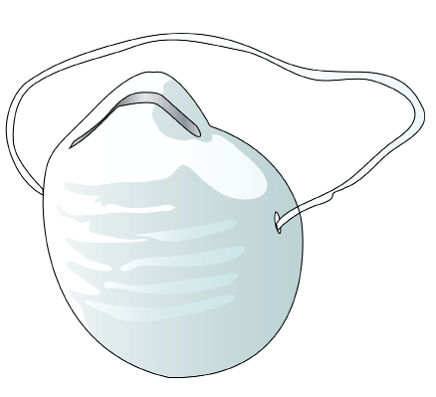
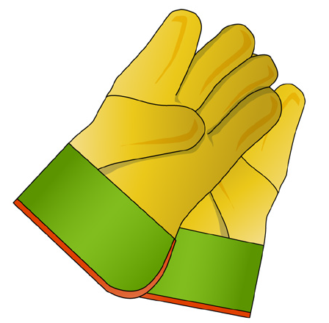
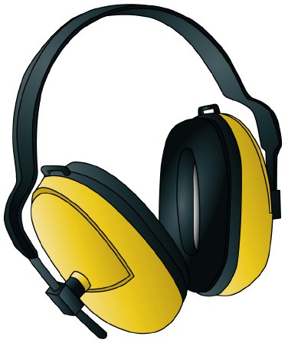
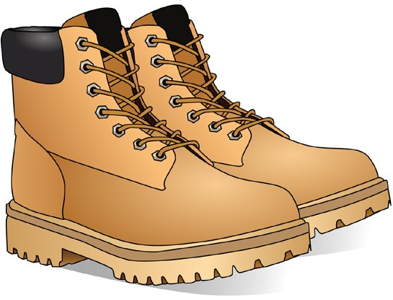
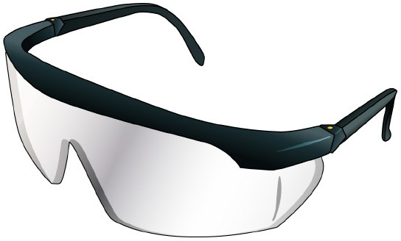
PLAN AND PREPARE FOR WORK
QUESTION 9
What kinds of PPE might you use when using earthmoving equipment?
You might use:
Dust mask
Safety vest
Hard hat
Ear muffs
Gloves
Boots that cover the whole foot
Sunscreen
Glasses/ googles

Slide 9
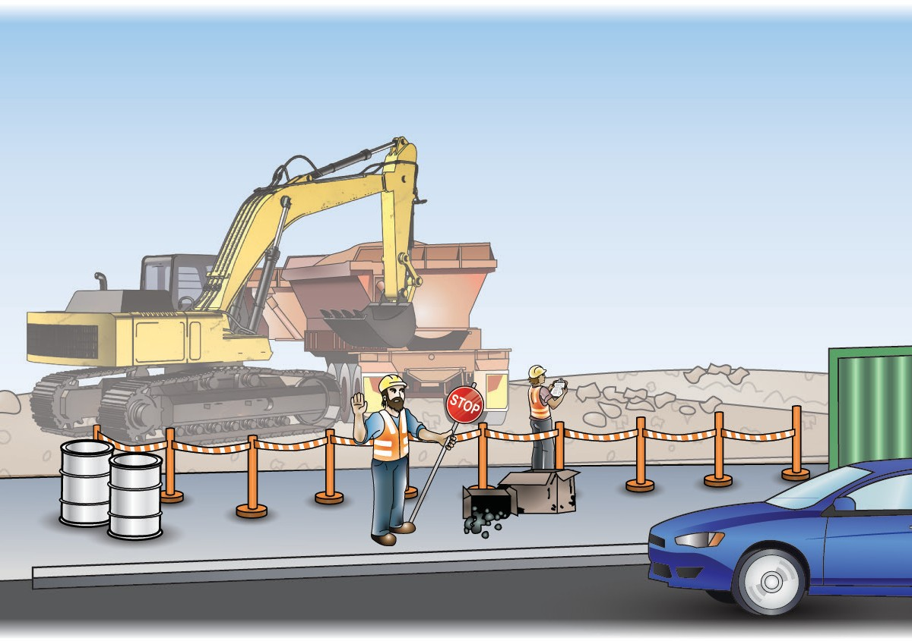
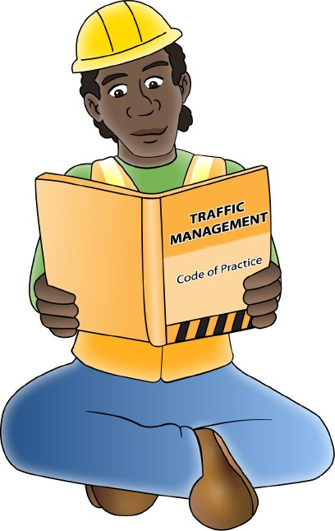
PLAN AND PREPARE FOR WORK
QUESTION 11
What does a traffic management plan (TMP) tell you?
It tells you how to control vehicles in and around the worksite. It helps keep the site safe for you and others.
You may require a traffic control qualification in your state or territory.

Slide 10
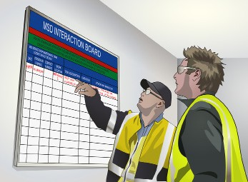
Communication – shift handovers
PLAN AND PREPARE FOR WORK
Handovers happen anytime one worker (or team of workers) takes over the job from another. For example, when one shift ends and another one starts. During the handover, the worker, or workers, leaving the job must give details about the job to the worker, or workers, taking over.
Some of the things that should be talked about during a handover include:
Hazard and hazard controls; for this you might use the Job Safety Environment Analysis (JSEA/JSA) or Safety Work Method Statement (SWMS)
Any problems with the job
How complete the job is; for this you might use the job plan
What part of the job has to be done next?
During handovers, keep in mind cultural differences.
For example, someone might have English as their second language. Take extra care to make sure they understand what you are telling them.
Always follow the handover procedures for your worksite.

Slide 11
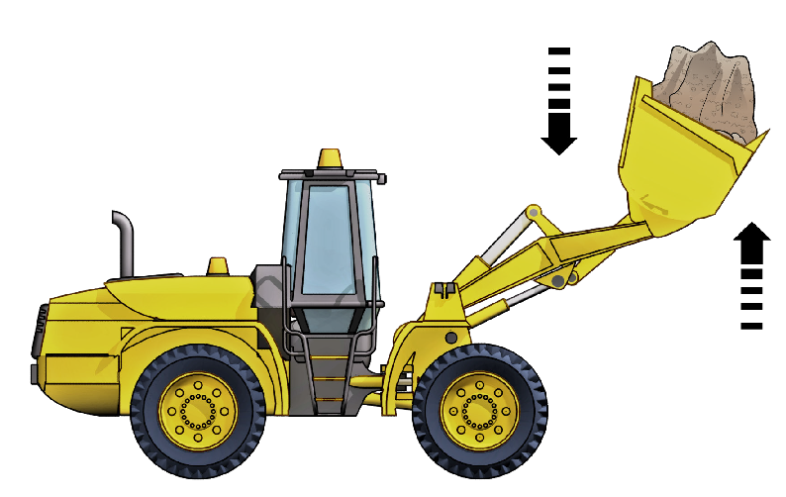
Operate earthmoving machinery

Slide 12
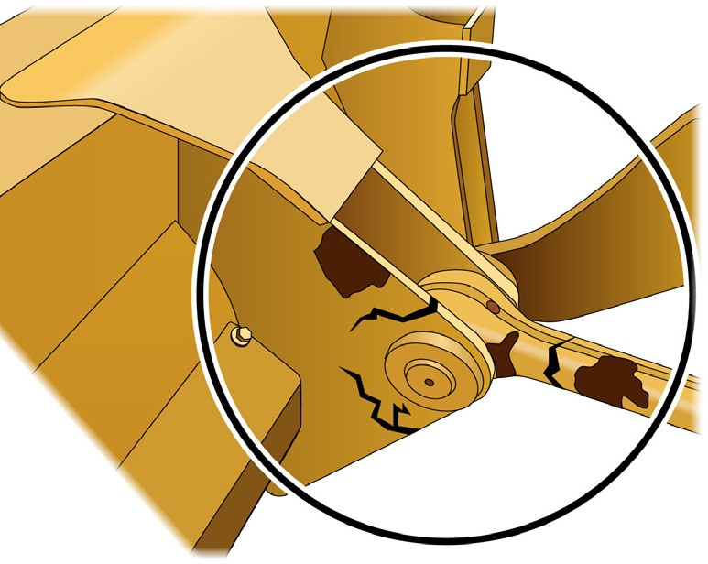
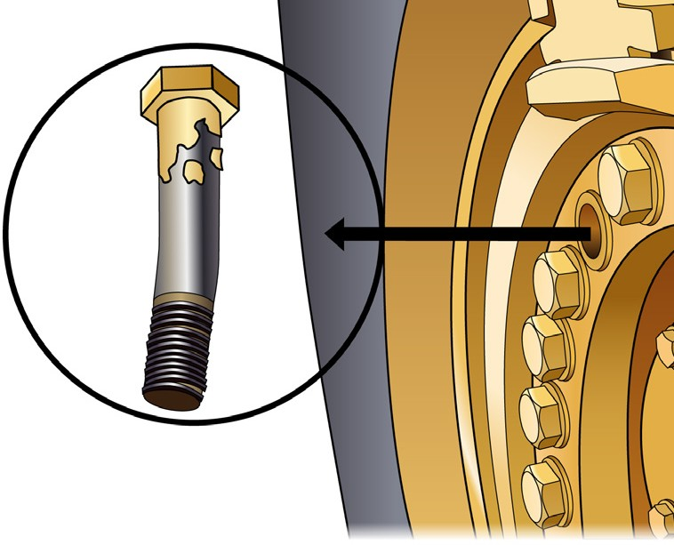
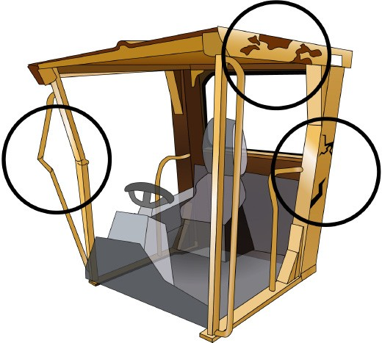
OPERATE EARTHMOVING EQUIPMENT
QUESTION 22 What checks do you do to an earthmoving machine’s moving parts and safety features? | Check the condition of attachments | Look for broken or damaged parts
 | Check that mounting bolts are attached on the falling object protective structure (FOPS) | Look for damage to the roll over protective structure (ROPS).

Slide 13
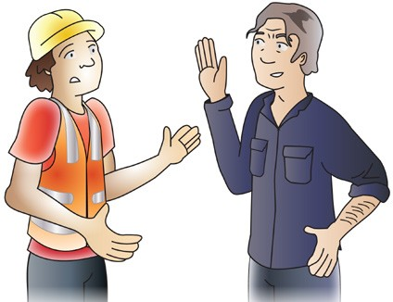
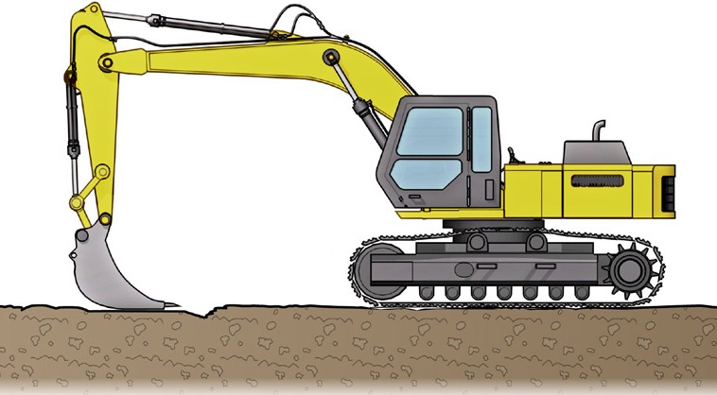
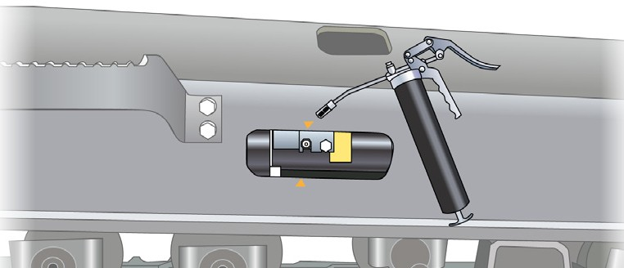
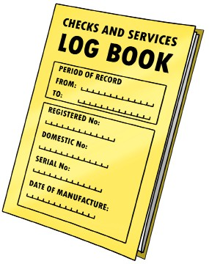
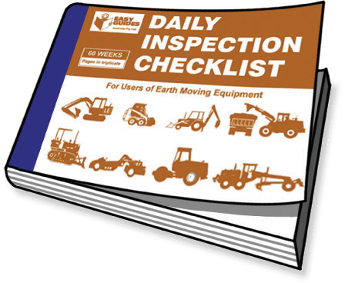
OPERATE EARTHMOVING EQUIPMENT
QUESTION 28
What do you do if you find loose tracks on the excavator or tracked loader?
1. Stop working. 2. Report to your supervisor.
3. Have the tracks adjusted.
QUESTION 29
Where do you record faults and repairs?
Record these in the logbook or daily inspection checklist.

Slide 14
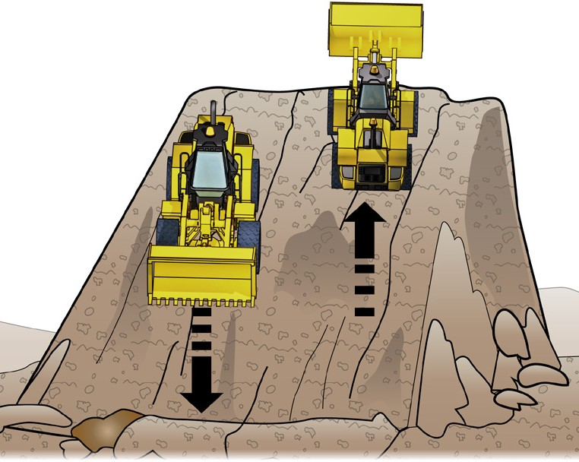
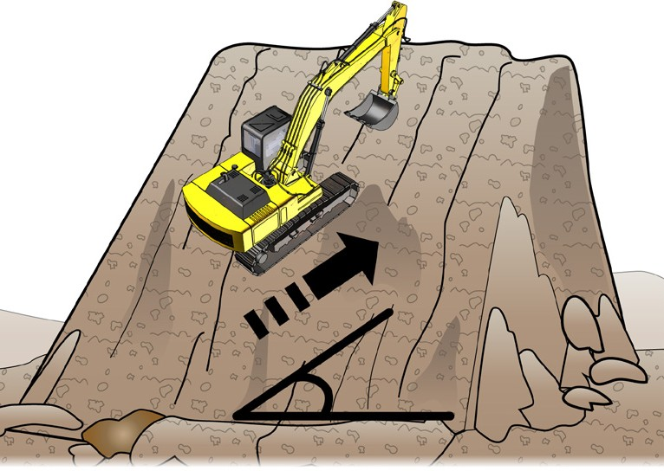
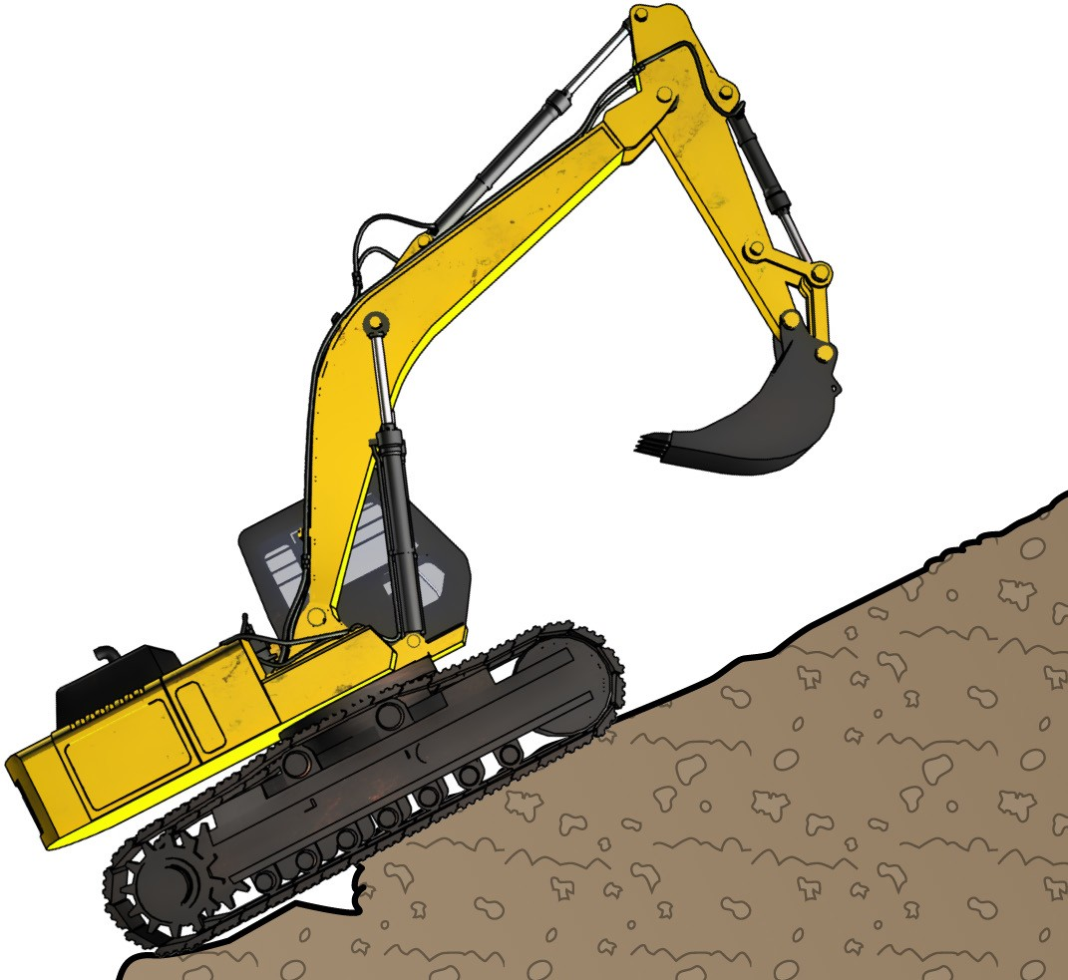
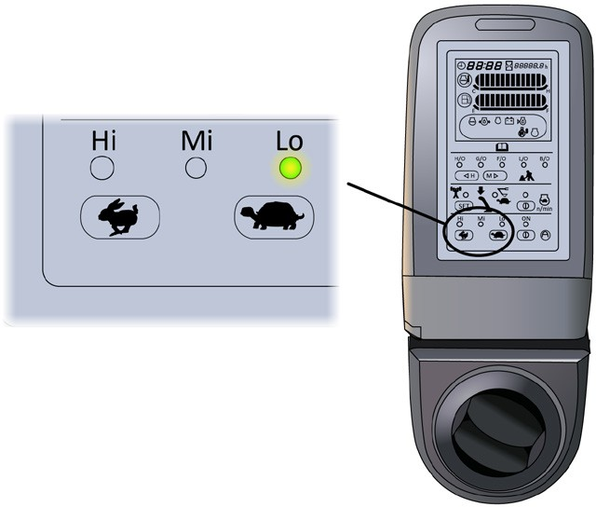
OPERATE EARTHMOVING EQUIPMENT
QUESTION 40 Which way should you travel when driving on sloping ground? | Go straight up or down the hill, not at an angle.
QUESTION 41 When travelling down a steep slope, which gear do you use? | Use the lowest gear you can. Change into low gear before you drive on the slope.

Slide 15
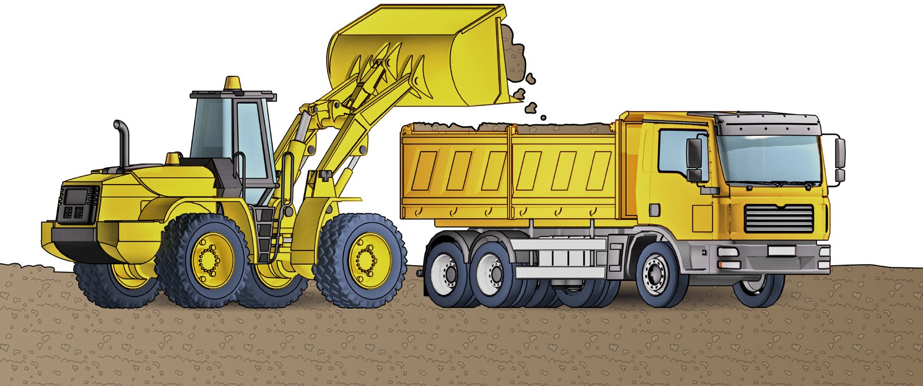
Lift, carry and place materials
LIFT, CARRY AND PLACE MATERIALS

Slide 16
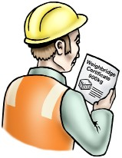
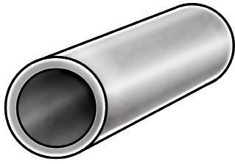
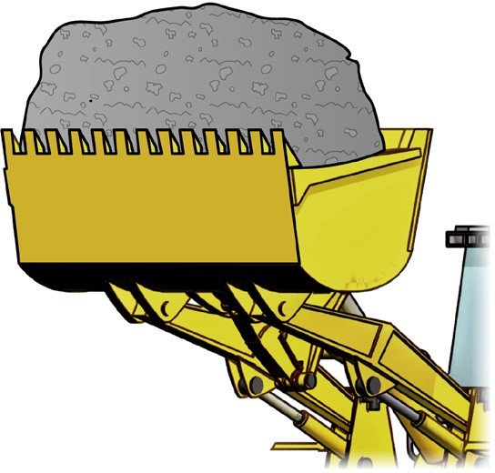
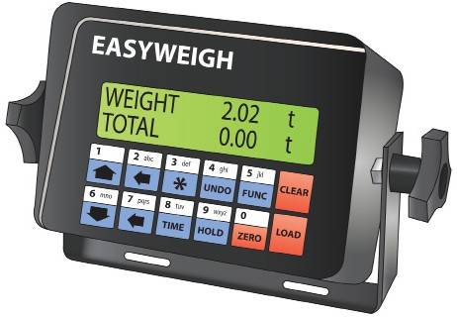
LIFT, CARRY AND PLACE MATERIALS
QUESTION 47 How can you find out the weight of a load? | Check the weighbridge note, consignment note, or other information. | Read the weight marked on the load
 | Estimate the weight of the load. For example, | Check the machine load scales if it has them fitted.
1000 kg

Slide 17
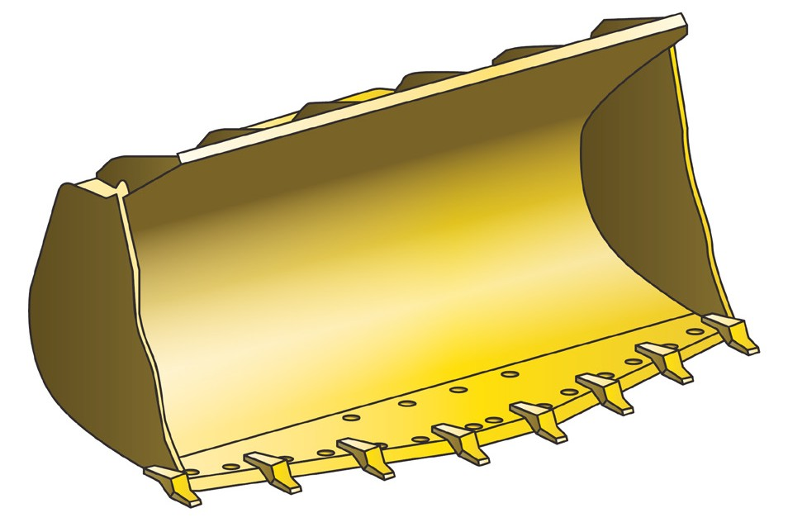
Select, remove and fit attachments
SELECT, REMOVE, FIT AND USE ATTACHMENTS

Slide 18
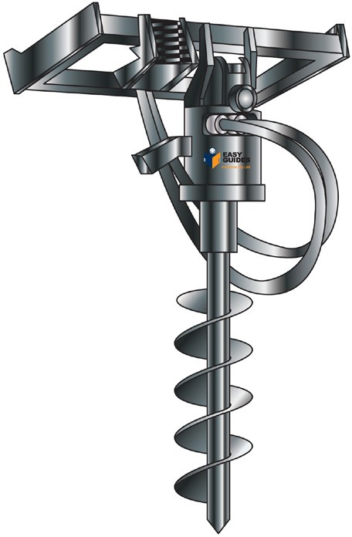
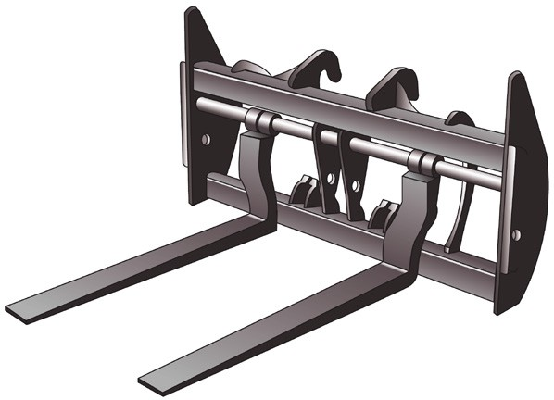
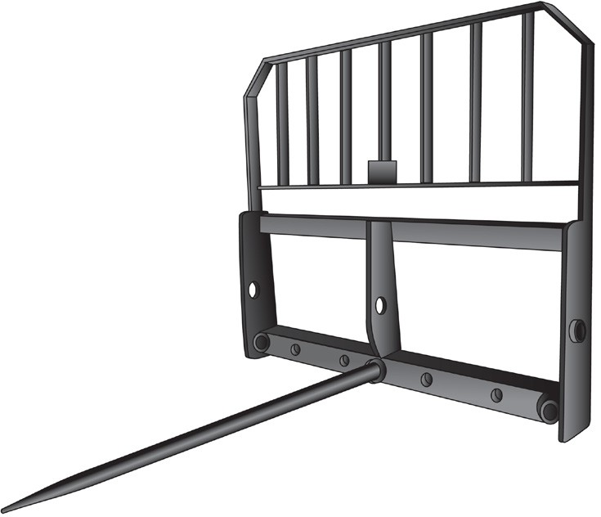
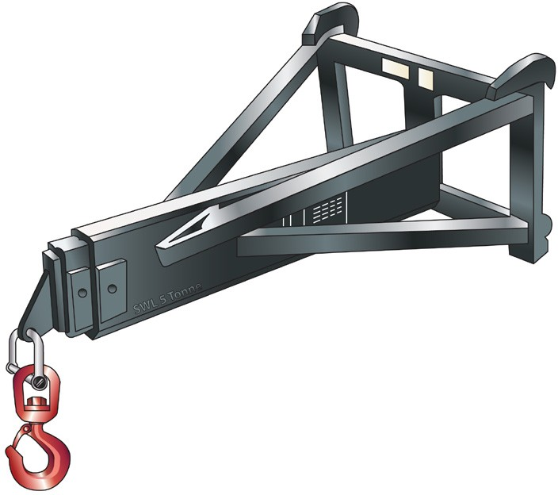
SELECT, REMOVE, FIT AND USE ATTACHMENTS
QUESTION 73 What are some attachments you might use on an integrated tool carrier? What do you use them for? | Pallet forks The pallet fork has tines on it. You use it to lift loaded pallets. Check the SWL of the integrated tool carrier and attachment before you use this attachment. | Hydraulic post hole digger (auger) You use this to dig holes. It uses the hydraulics on the integrated tool carrier.
 | Round bale fork The bale fork has spikes on it. You use the bale fork to lift things like hay bales. | Jib attachment to lift loads

Slide 19
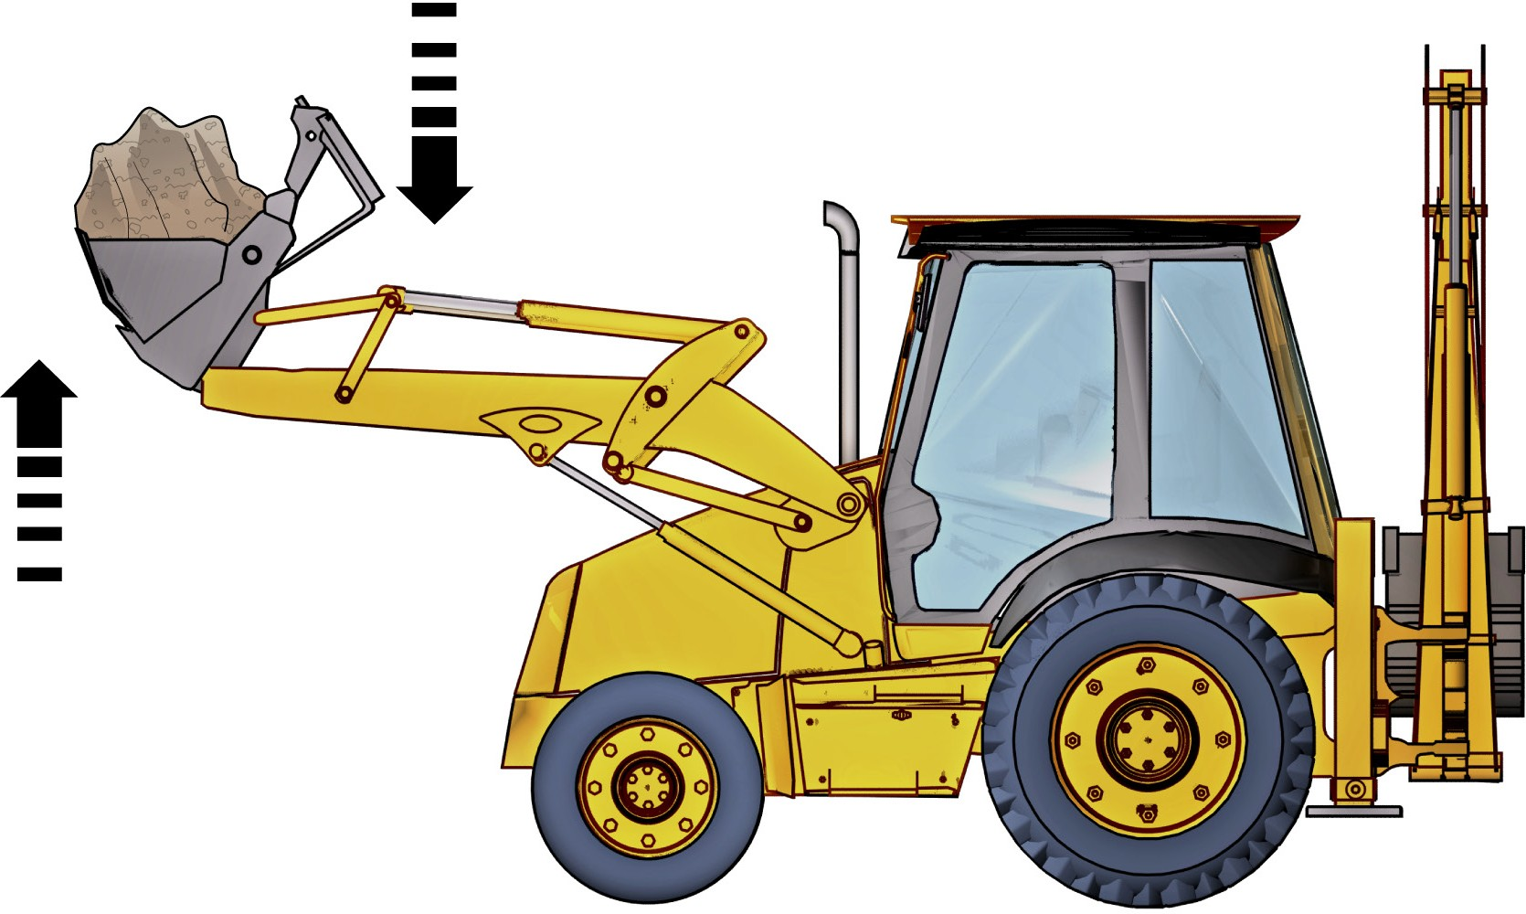
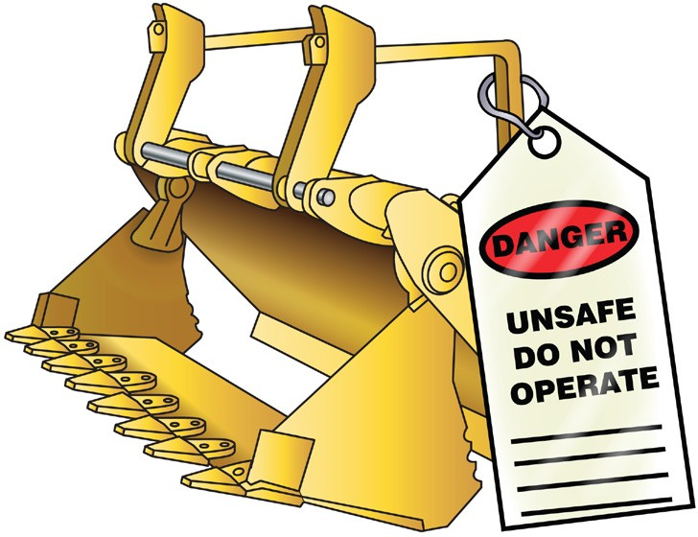
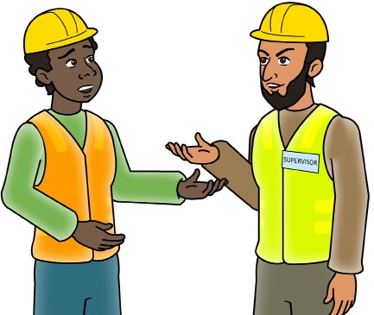
SELECT, REMOVE, FIT AND USE ATTACHMENTS
QUESTION 82
How do you test the attachment before moving a load with it?
Test all functions of the attachment. For example, lift it up and down and try to lift something.
QUESTION 83
What do you do if you find a fault while testing the attachment?
1. Tag out the attachment and
DO NOT USE IT.
2. Report the fault and arrange to have the attachment repaired.

Slide 20
Relocate the machine
PREPARE TO RELOCATE MACHINE

Slide 21
PREPARE TO RELOCATE MACHINE
QUESTION 92
Before you drive on a public road, what checks do you make on the machine?
Make sure the machine is roadworthy, and it is registered for road use. All brake lights, indicator lights, horn etc must be in working order.
Lift the bucket to a height that will clear the road but allow a good view of the road ahead.
Note:
If the backhoe/loader is not registered you may be able to get an unregistered vehicle permit (check with your relevant state/territory authority).
QUESTION 93
Do you have to follow the same traffic rules as other vehicles on public roads?
Yes. Sometimes larger vehicles have stricter rules, for example:
Can’t drive in the right lane on freeways
Can’t travel on some roads because of weight limits
...CONTINUES ON NEXT PAGE

Slide 22
PREPARE TO RELOCATE MACHINE
QUESTION 96
A loader is to be transported. How is the preparation done by the person responsible?
Make sure the transport vehicle is wide enough
and long enough to fit the loader
Make sure the transport vehicle is clean
Make sure the park brake is on in the transport vehicle
Use traffic control
measures
The transport vehicle has enough capacity to carry the loader
Set up the transport vehicle
on firm, level ground
Keep people clear

Slide 23
Carry out post- operational procedures
POST OPERATIONAL CHECKS

Slide 24
POST OPERATIONAL CHECKS
QUESTION 99 | Check for: Correct fluid levels (once the integrated tool carrier has cooled down) | Any structural damage Any fluid leaks
You’ve finished using
earthmoving machinery.
What post-operational
checks do you do?

Slide 25
Housekeeping
HOUSEKEEPING

Slide 26
Disposing of environmentally sensitive fluid
HOUSEKEEPING
There are times when you will need to dispose of environmentally sensitive fluids. You may have to deal with oil spills
or chemical spills.
There are disposal companies who remove used oil, oily water and emulsions, waste grease, filters, rags, brake fluids
and coolants.
Oil is a good example of an environmentally sensitive substance that needs to be disposed of properly.

Slide 27
The damage oil and chemicals can do
HOUSEKEEPING
If oil ends up in landfill, it will slowly leach into surrounding
land and underground water.
Storm water and sewage, polluted by oil, can cause long term damage to coastal and marine habitats and ecosystems, seabirds, mammals, fisheries and people.
Clean up
Recycling items
Many environmentally sensitive items can be recycled. Items such as batteries, oil and gas cylinders can sometimes be recycled and reused.
Some oils can be taken to a recycling centre. With oil, bring your materials to the recycling centre in a clean, plastic container with a lid. The original container is a good container to return the oil in.

